Slide 1
Auto layout in iOS

Slide 2
Auto layout in iOS
When Apple only had one device and one screen size it made developer’s lives easier since they only had to design for one screen size.
When Apple started releasing devices with different sized screens and resolutions developers needed to take this into account when designing the UI of their apps. Much like Web Developers need to account for different screen sizes and resolutions.

Slide 3
Auto layout in iOS
At WWDC 2012, Apple announced the Auto Layout which would help developers design their user interfaces so they would look good on any of Apple’s screen sizes and resolutions.
Lets look at an example of an app that does not utilize Auto Layout

Slide 4

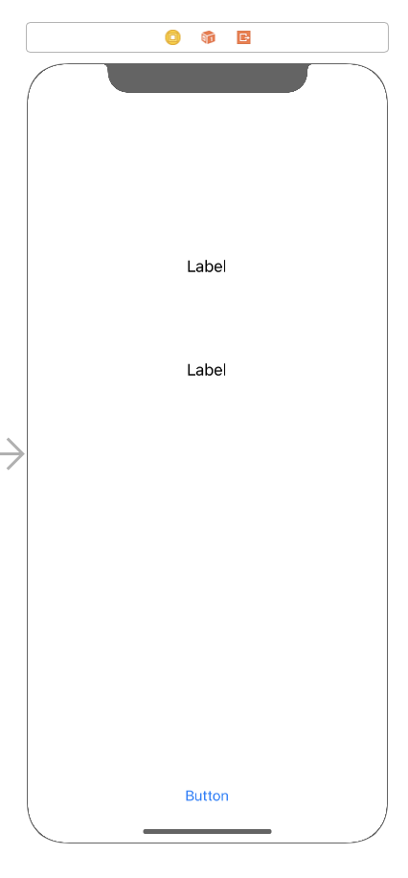
iPhone X Portrait Mode
This was the original view in which the labels and the button were placed in the IDE. the labels are centered horizontally and the button on the bottom of the view. Not too bad right?
Well, lets change the orientation and screen sizes and see how it looks then

Slide 5
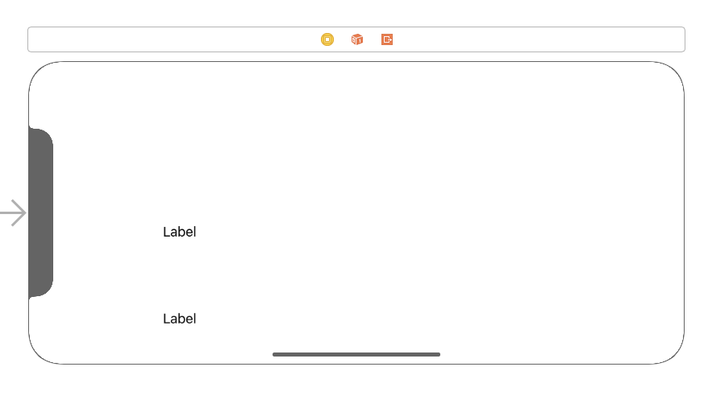
iPhone x Landscape mode
When we switch to landscape mode we can see that the labels have moved position and are no longer centered and the button is no longer displayed on the screen. It is beyond the viewing area of the device

Slide 6

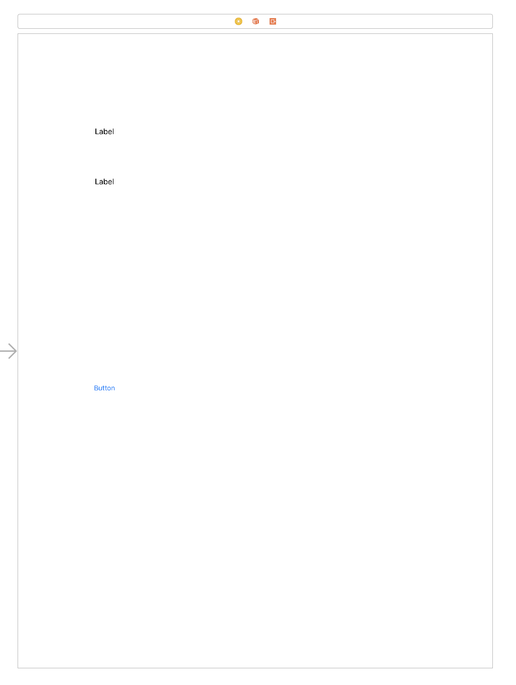
iPad Pro 12.9” Portrait mode
Notice how much wasted space there is

Slide 7
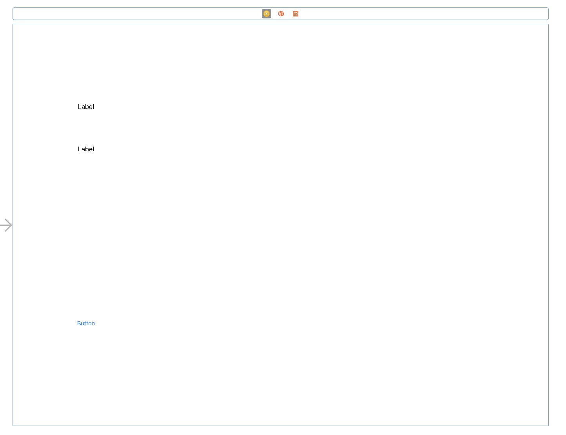
iPad Pro 12.9” landscape mode

Slide 8
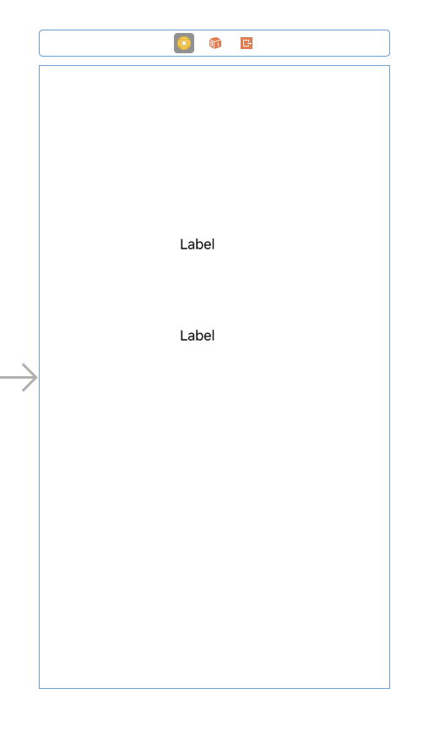
iPhone 8 plus Portrait mode

Slide 9
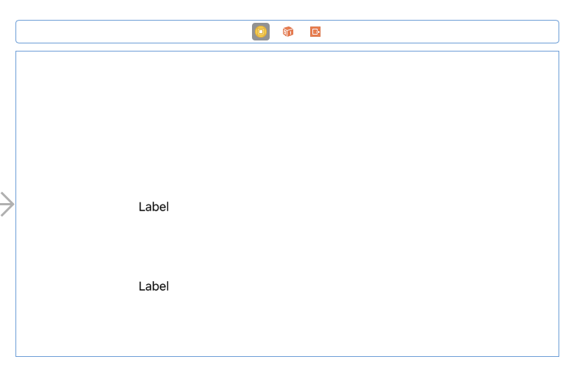
iPhone 8 plus landscape mode

Slide 10
Auto layout in iOS
So how can we make it so the UI looks consistent no matter what the screen size, resolution or orientation? We use Auto Layout!
Auto Layout is a constraint-based layout system. It allows developers to create an adaptive interface that responds appropriately to changes in screen size and device orientation. These constraints express rules for the layout of label or other views in the interface relative to other views or the root view. Auto Layout is all about constraints.

Slide 11
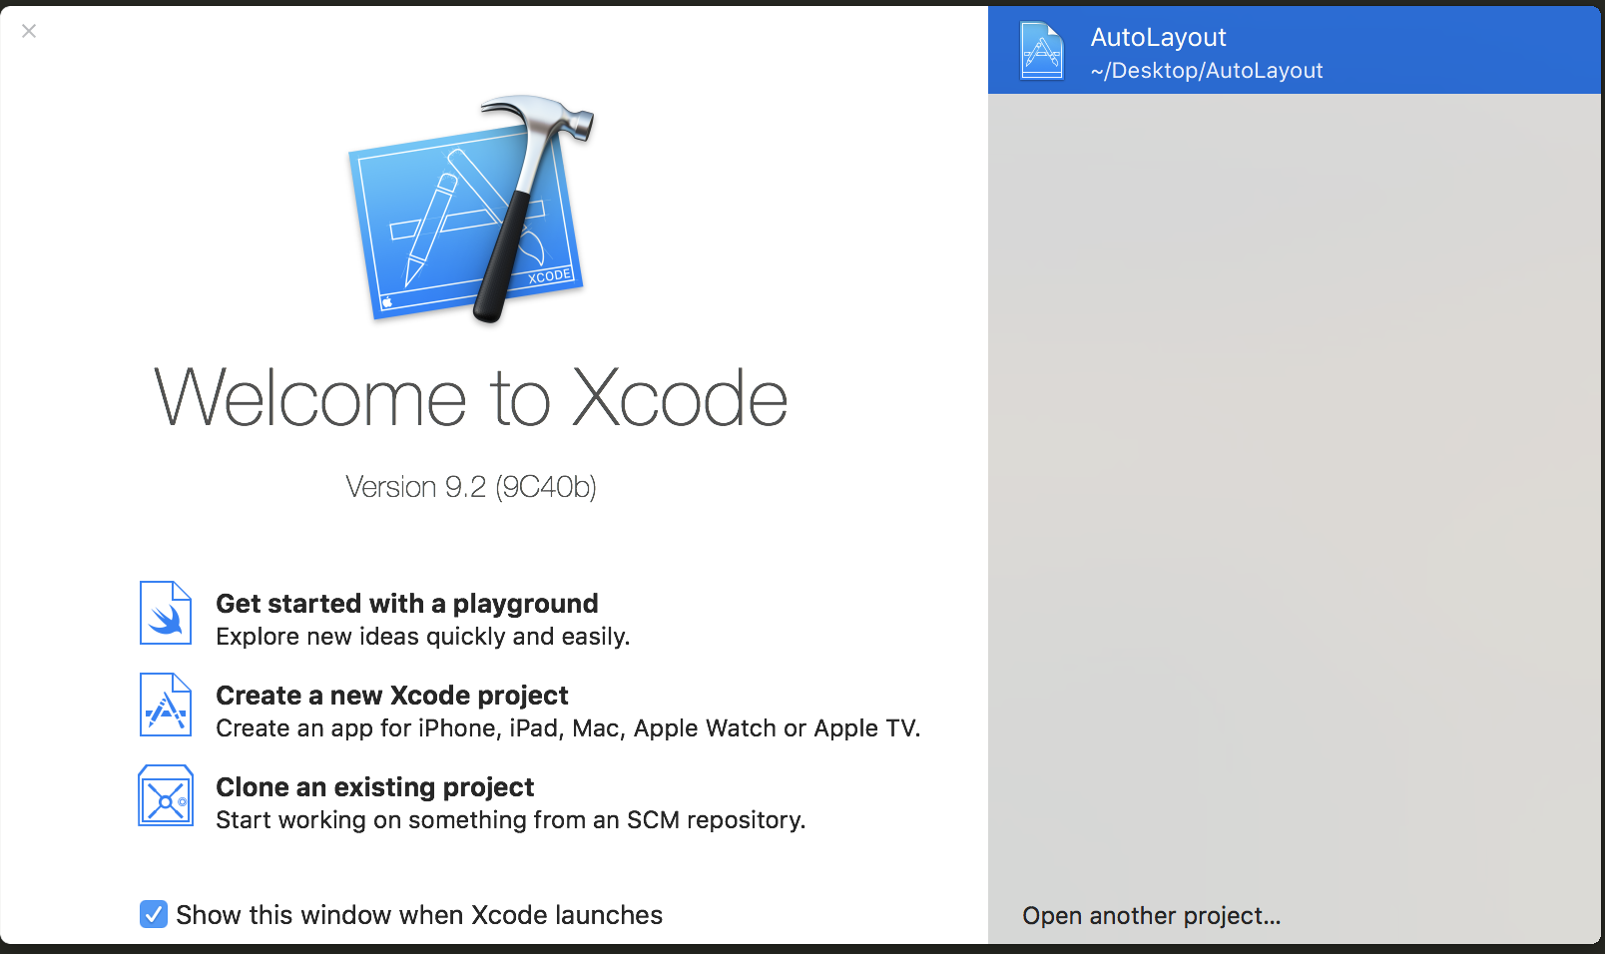
So now let’s begin working with Auto Layout.
Open Xcode and create a new project.

Slide 12
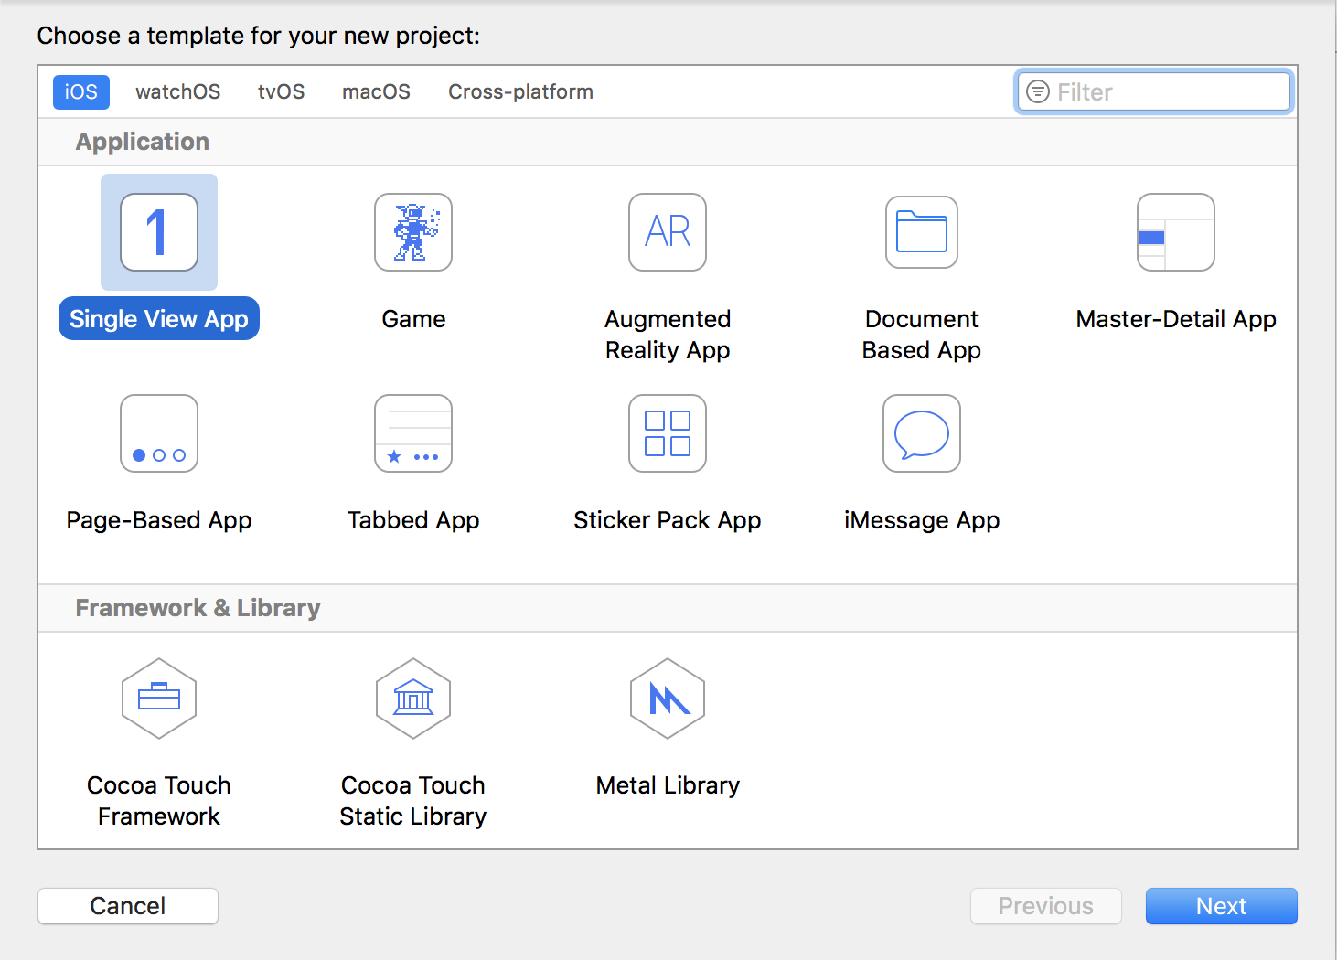
Select “Single View App” and click ”Next”

Slide 13
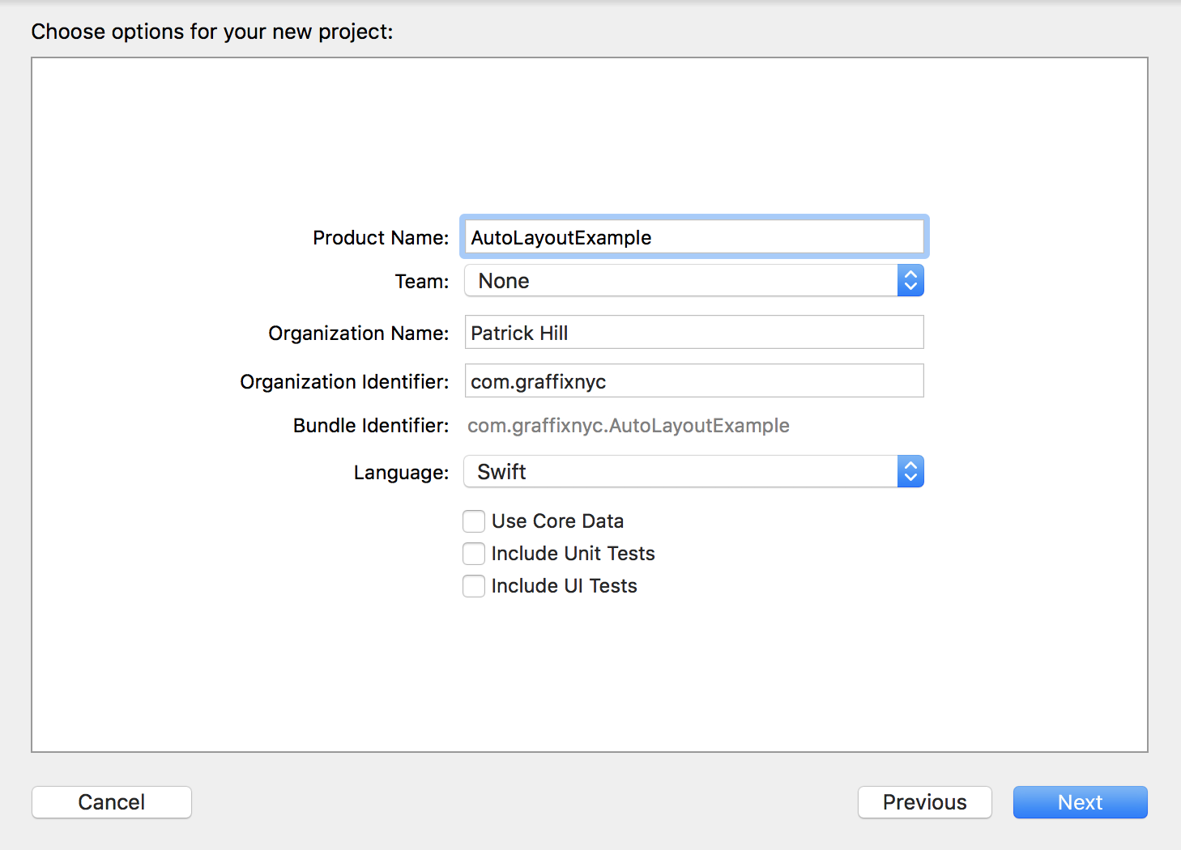
Give it the name “AutoLayoutExample”
For Team, if you already have a personal team created and added into Xcode, select that, if you do not have one leave “None” selected and we will create one in a few minutes
For Organization Identifier the usual format is the domain of your company reversed. In this example I use com.graffixnyc which graffixnyc.com is my domain. For testing purposes you can make this whatever you like. ‘com.example’, ’edu.stevens’ etc…
Make sure Use Core Data, Include Unit Tests, and Include UI Tests are unchecked and click “Next”

Slide 14
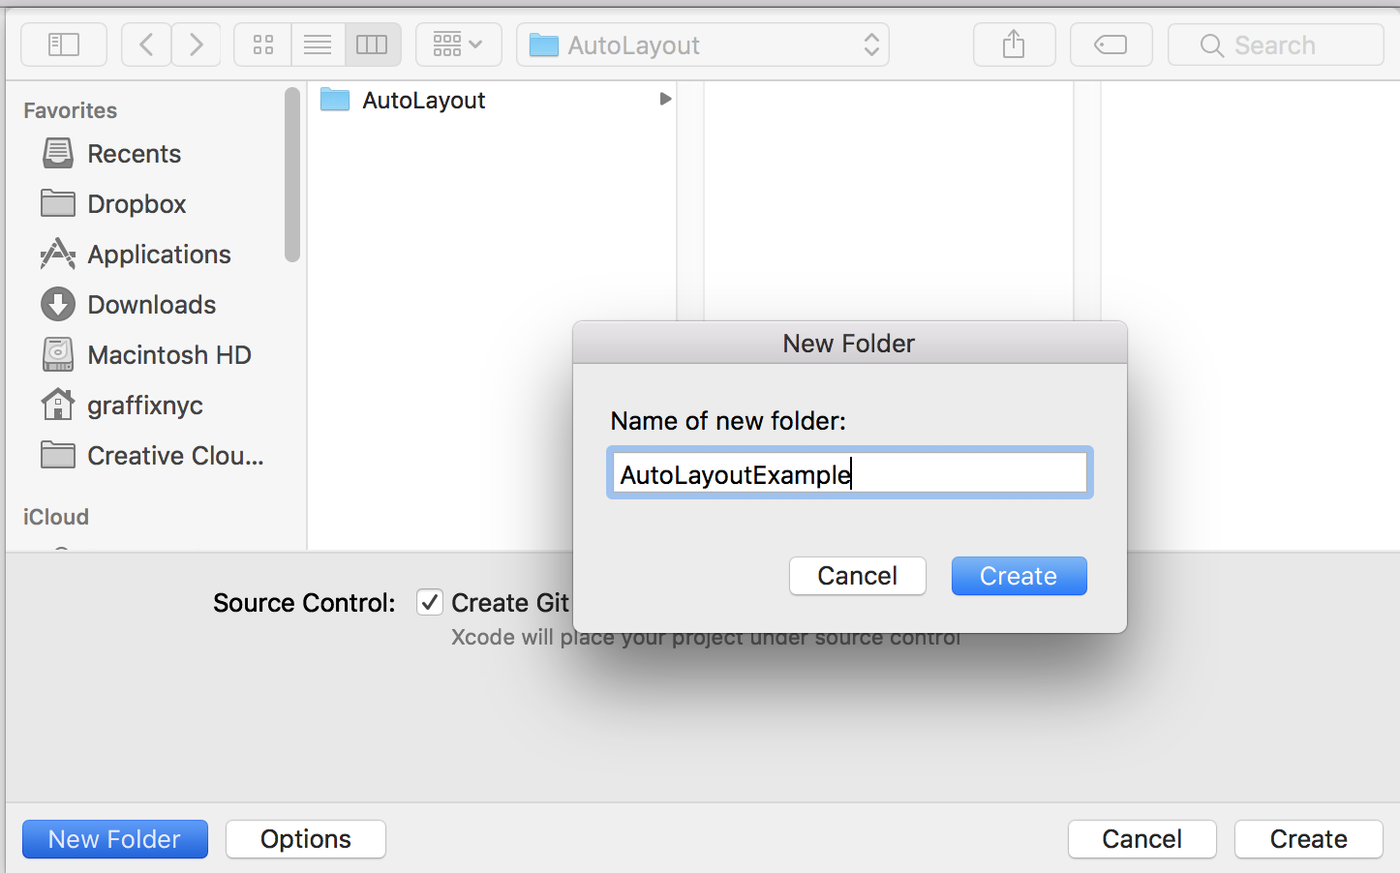
On the Next screen we tell Xcode where to save the project. Select which ever root folder you wish to save the project in and click “New Folder” and give it the name “AutoLayoutExample” and then click “Create” and then click “Create” again

Slide 15
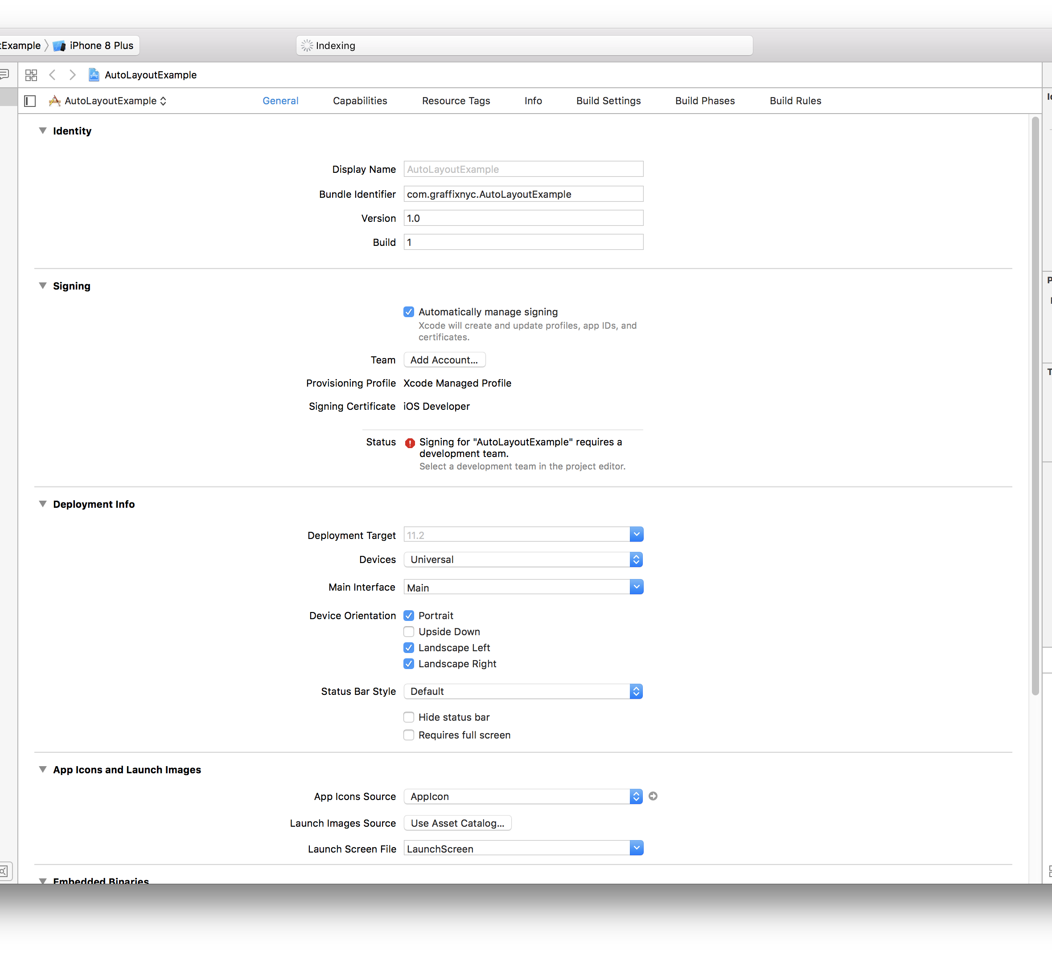
This is what the next screen will look like. If you do not already have an Xcode personal team you’ll need to add one by using your Apple ID.
From the Team section, click the “Add Account” button.

Slide 16
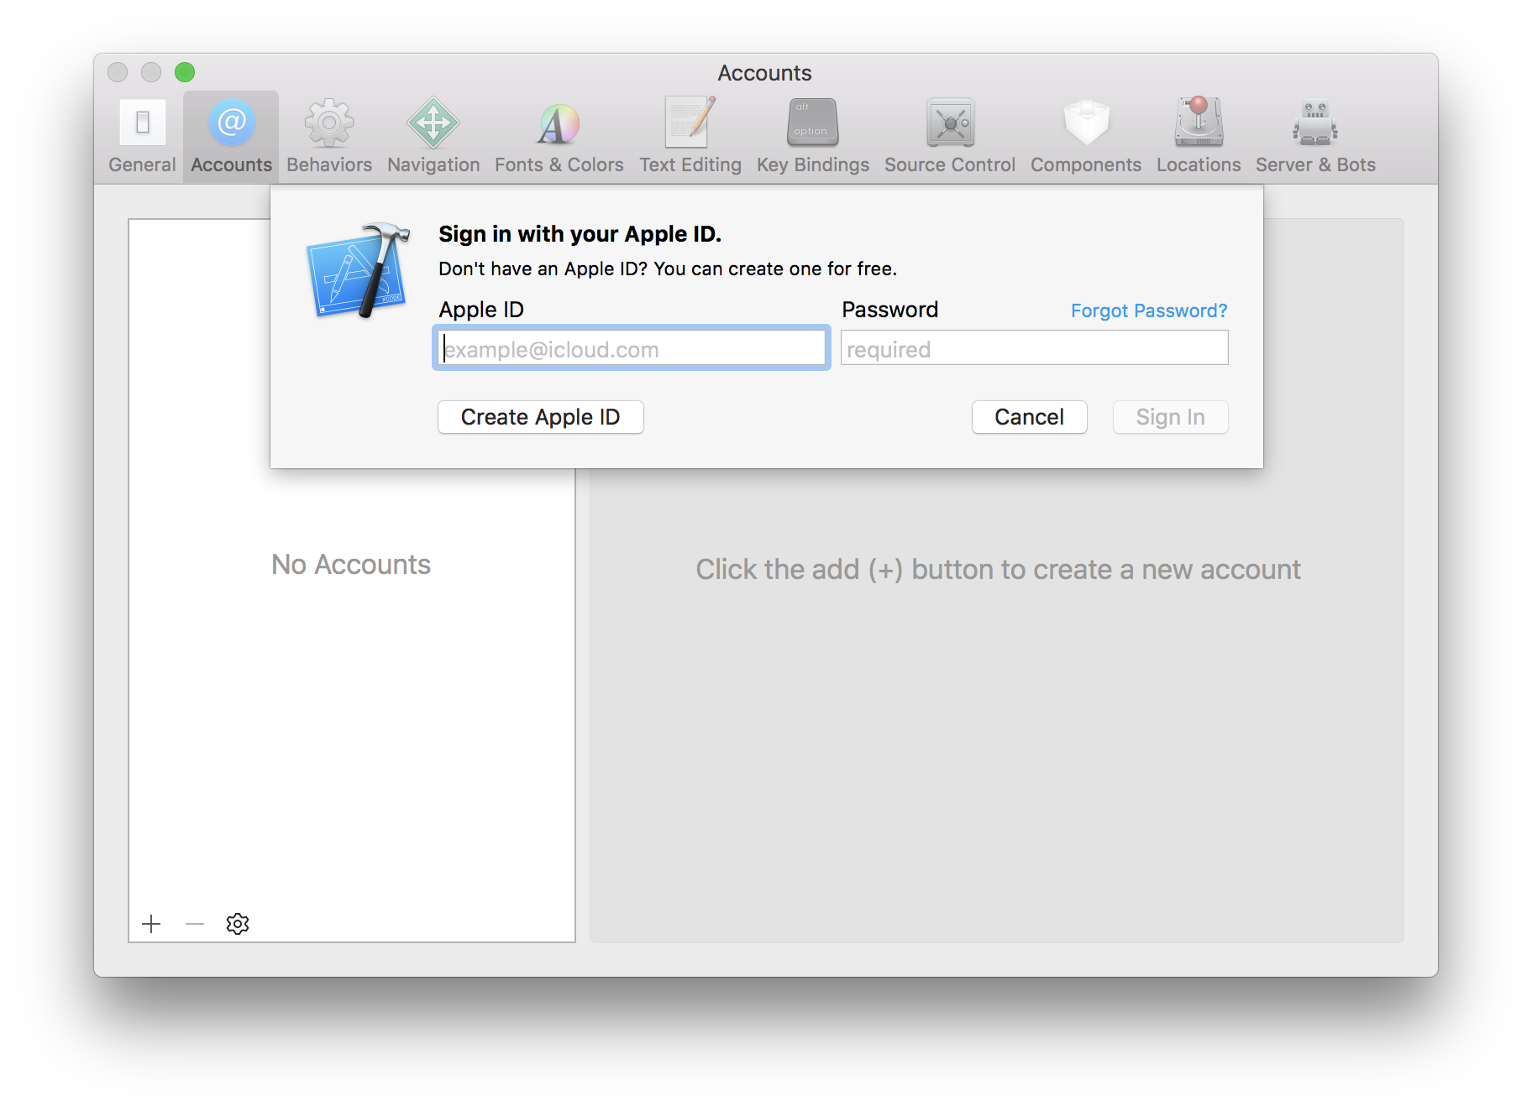
Enter your Apple ID and password (or create one if you do not have one) and click “Sign In”

Slide 17
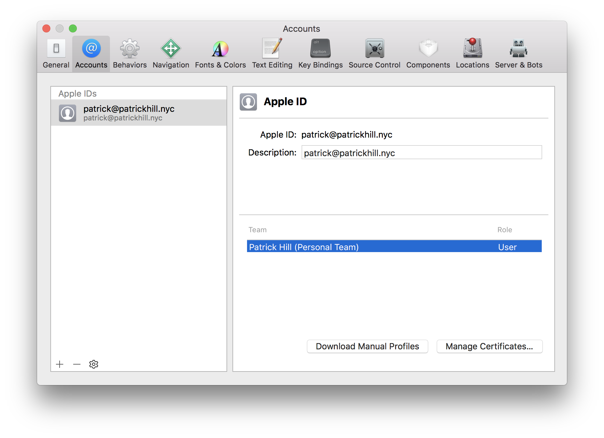
Once you sign in, this will be what your screen should look like.
If you need additional help on setting this up please refer to the documentation: https://help.apple.com/xcode/mac/current/#/devaf282080a

Slide 18
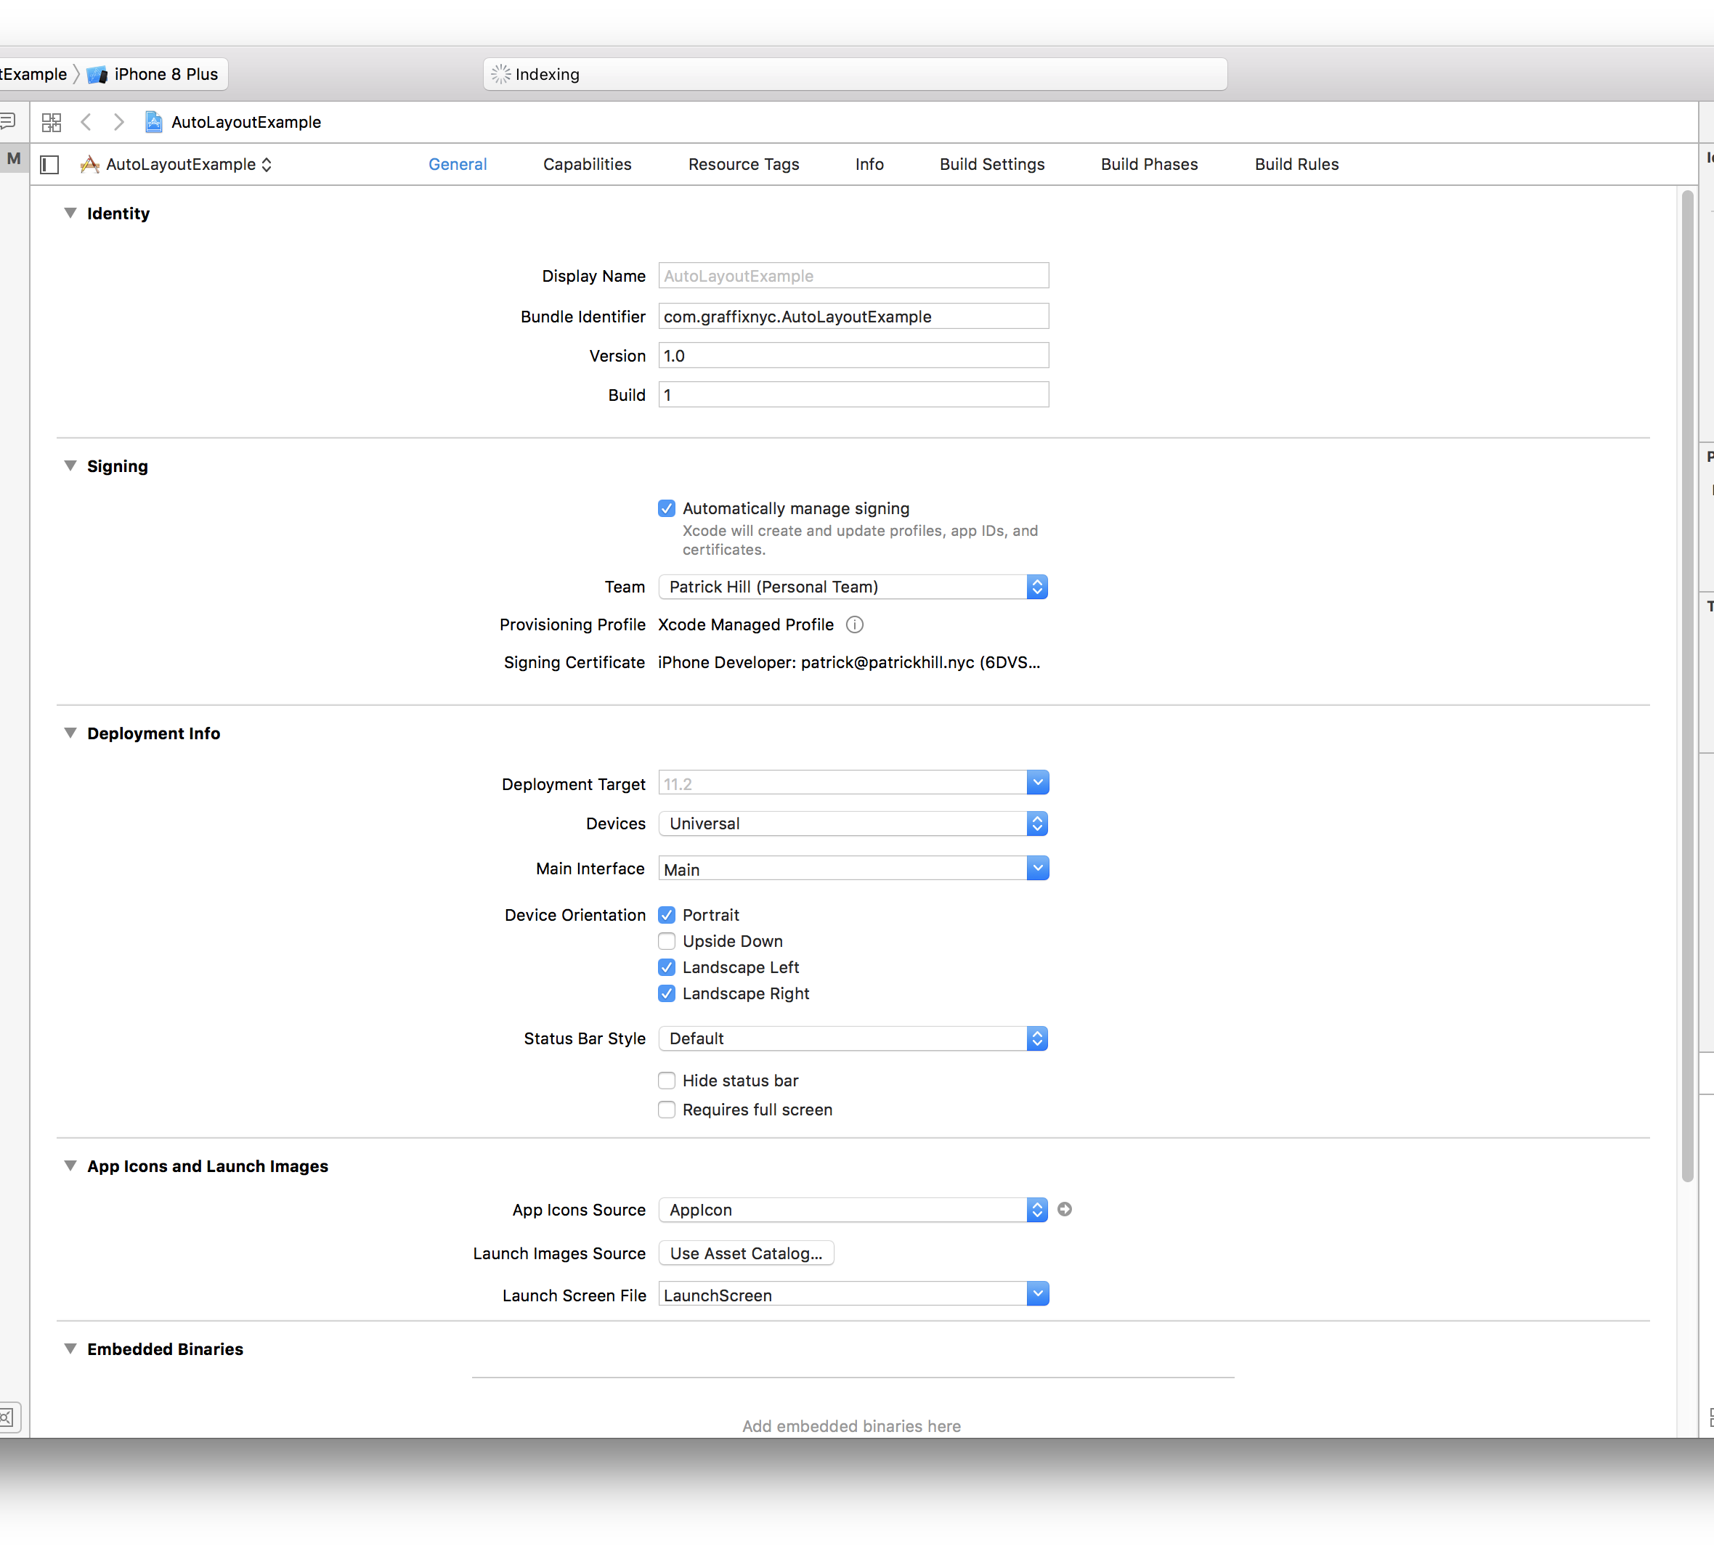
Now in the Team dropdown select your personal team.

Slide 19

Now we are going to open up the Interface Builder. Double click “Main.storyboard” in the left hand side pane.
The Main storyboard is the main screen of the application when it is run. This is where we will design the UI for the application

Slide 20
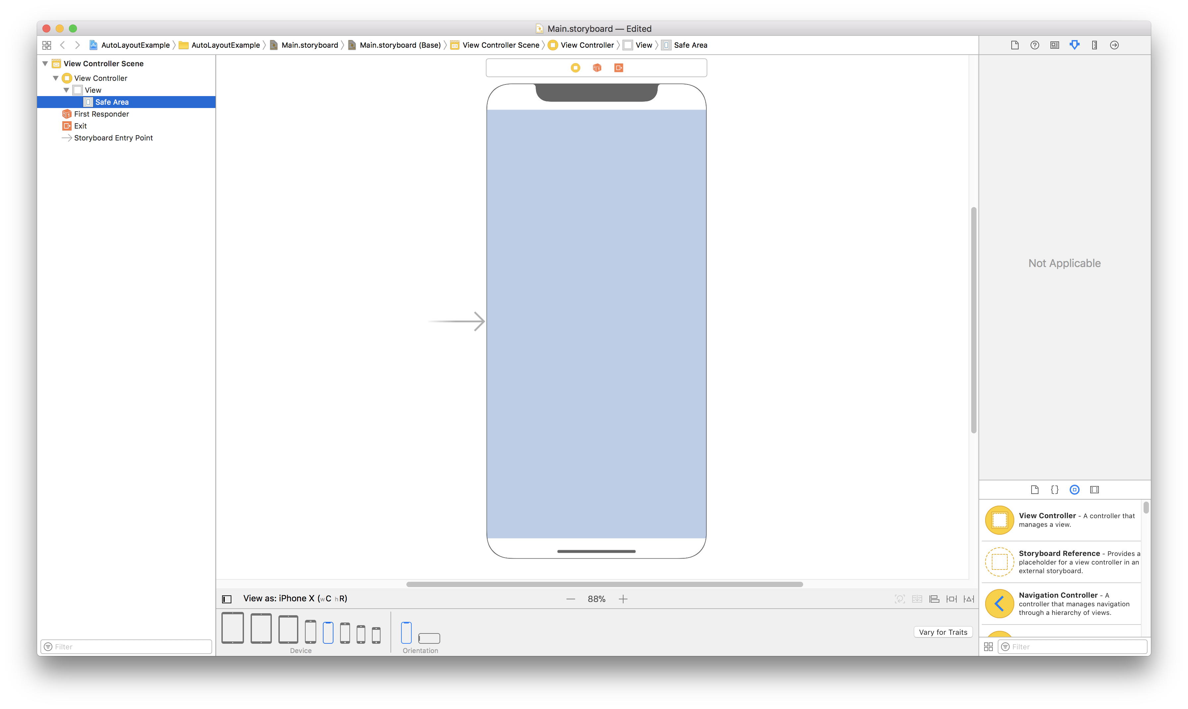
The left side pane of the interface builder shows the hierarchy of views in the project. We can see we have two views in the View Controller, View, and Safe Area.
We are now going to add a label to the view controller.

Slide 21
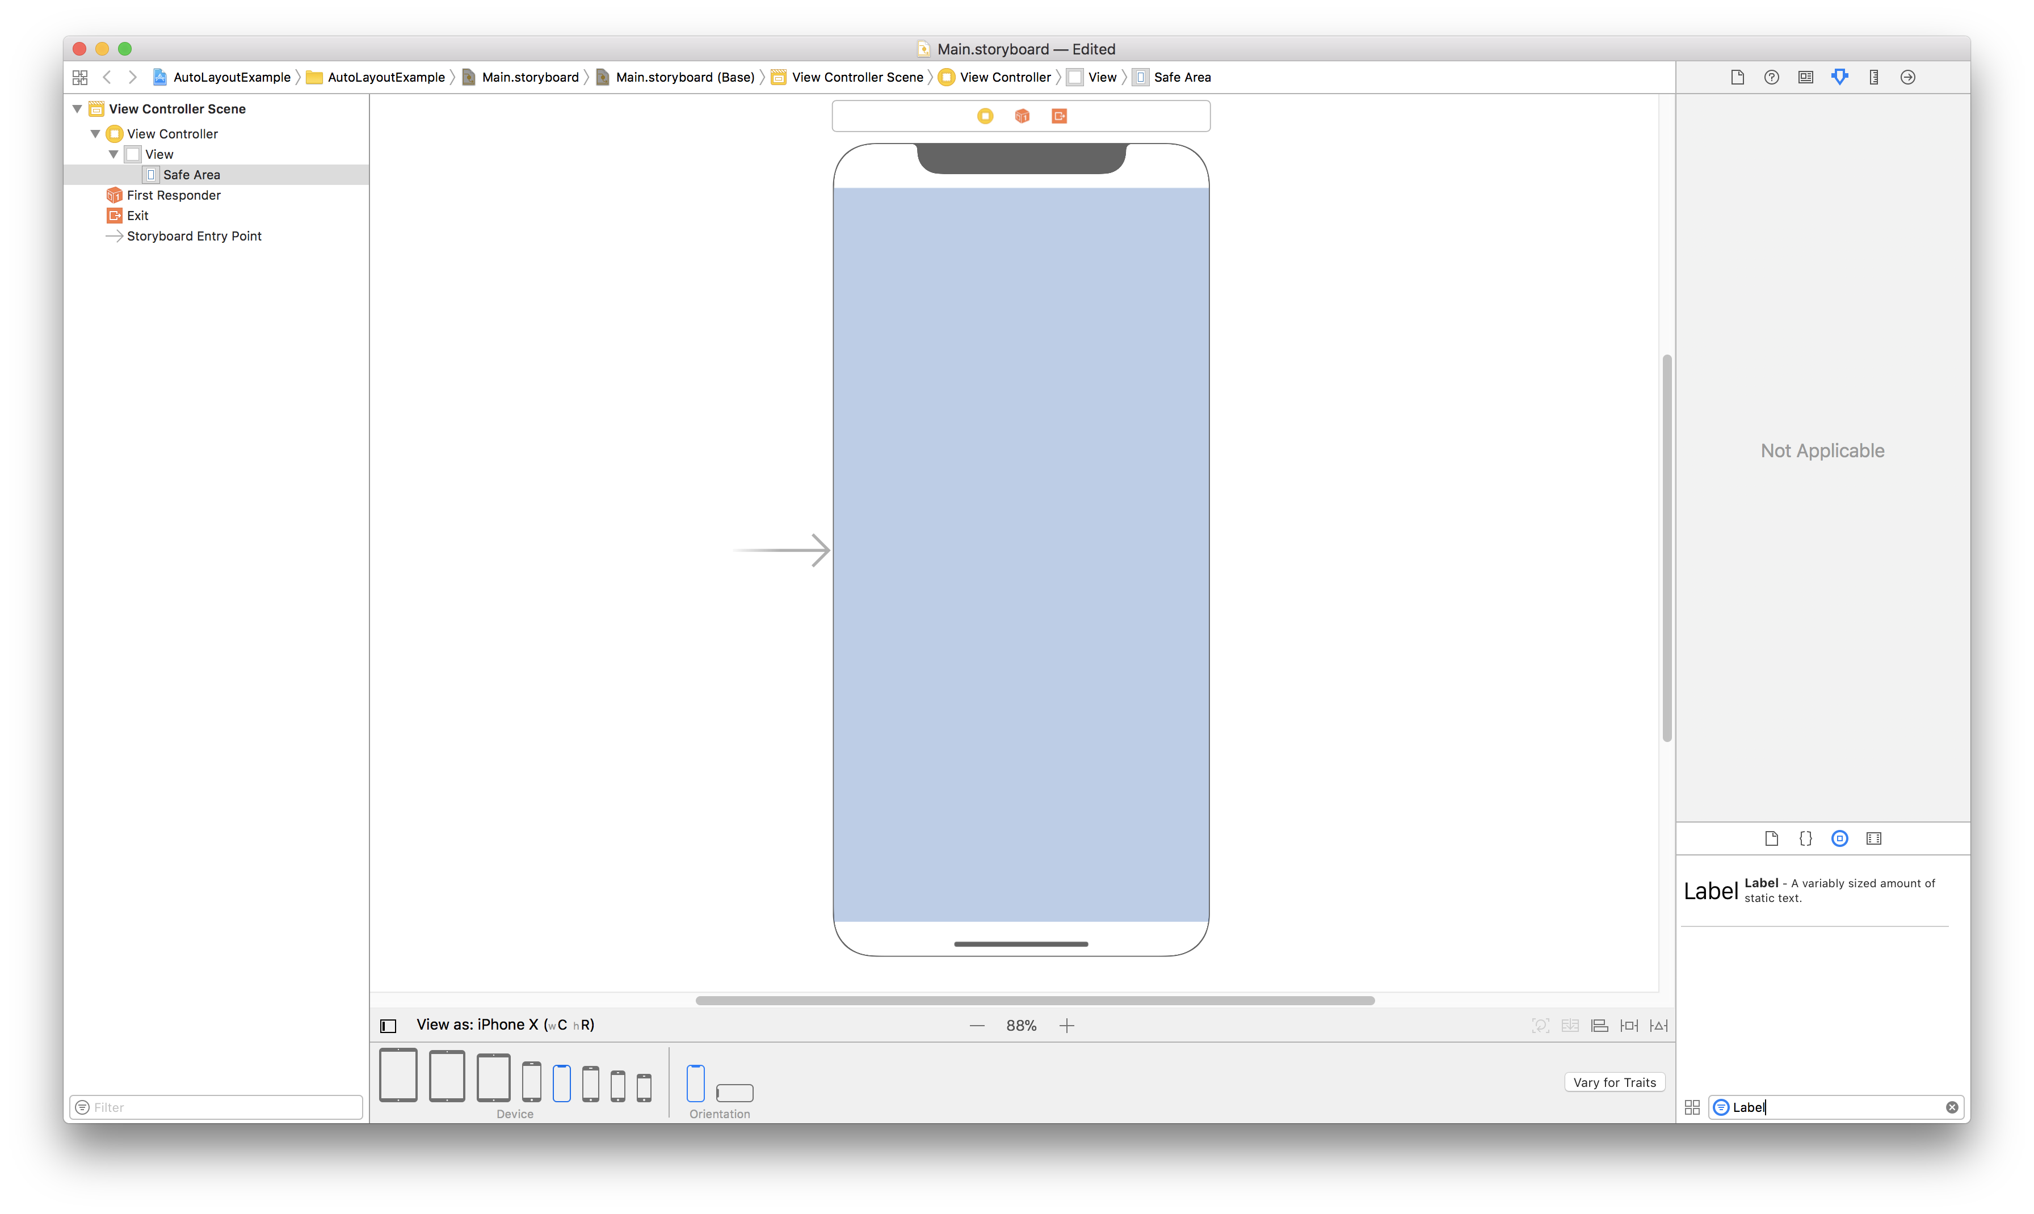
On the bottom right pane make sure the 3rd option “Show the Object Library” is selected, and type “Label” into the filter textbox.

Slide 22
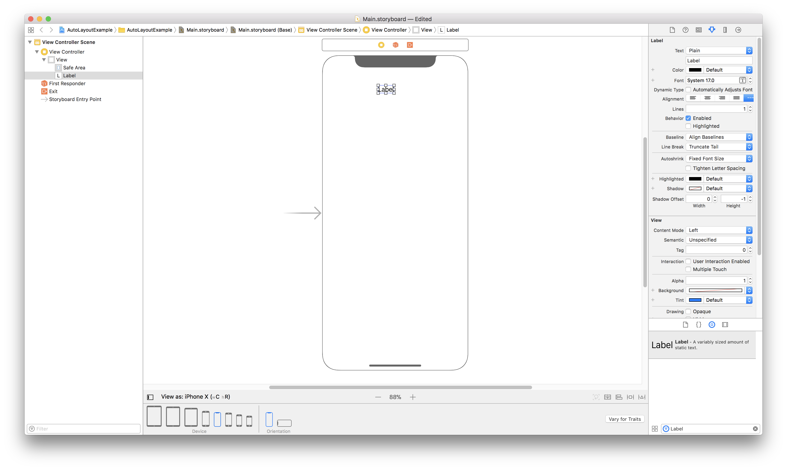
Once you see the label in the list, drag it to your view.

Slide 23
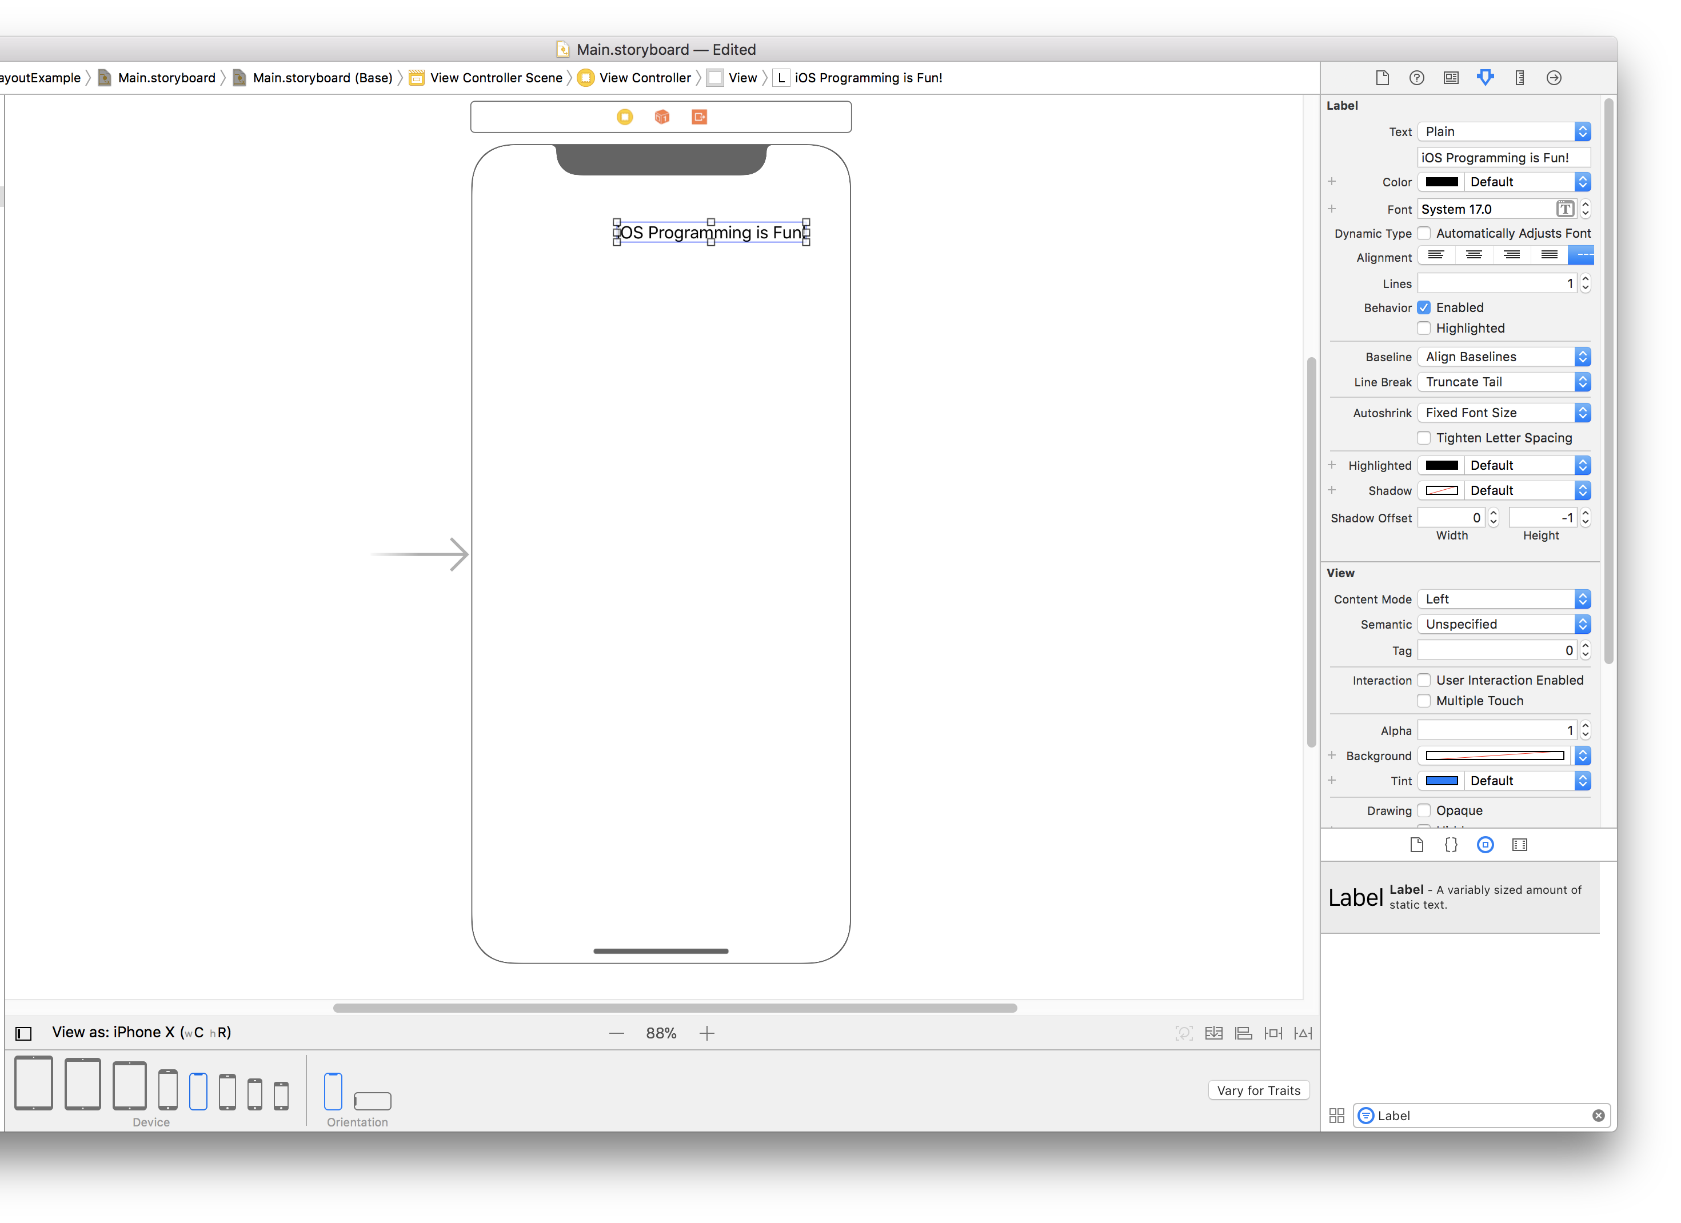
Properties
We are going to change the text of the label to say “iOS Programming is Fun!”
You can either double click the label and change the text or from the properties pane on the right side.
You can also use the properties pane to change the text. Make sure Properties is selected
Double Click and type to change Text

Slide 24
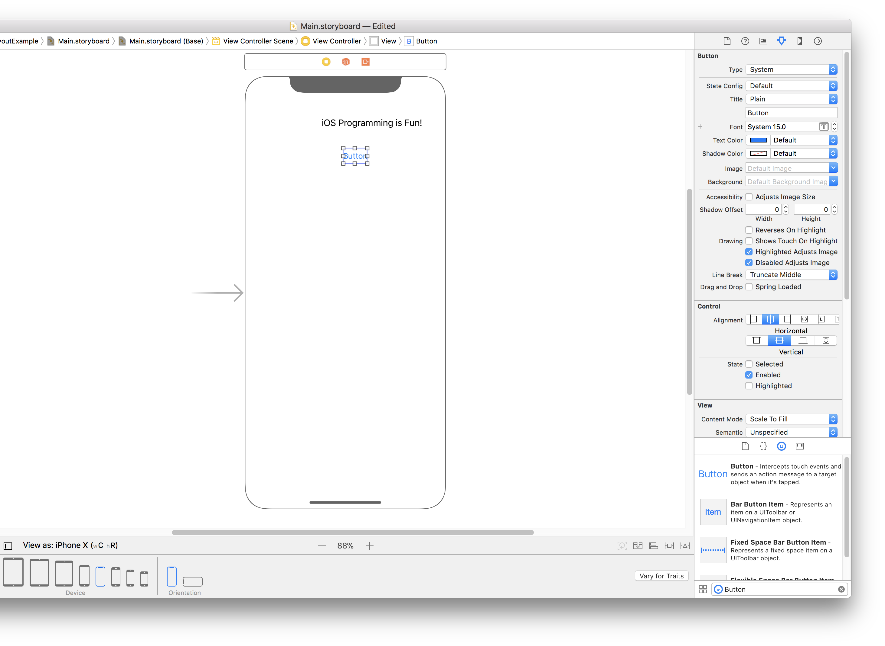
We are also going to add a button, so repeat the steps to add a button
Drag the button to the screen below the label

Slide 25
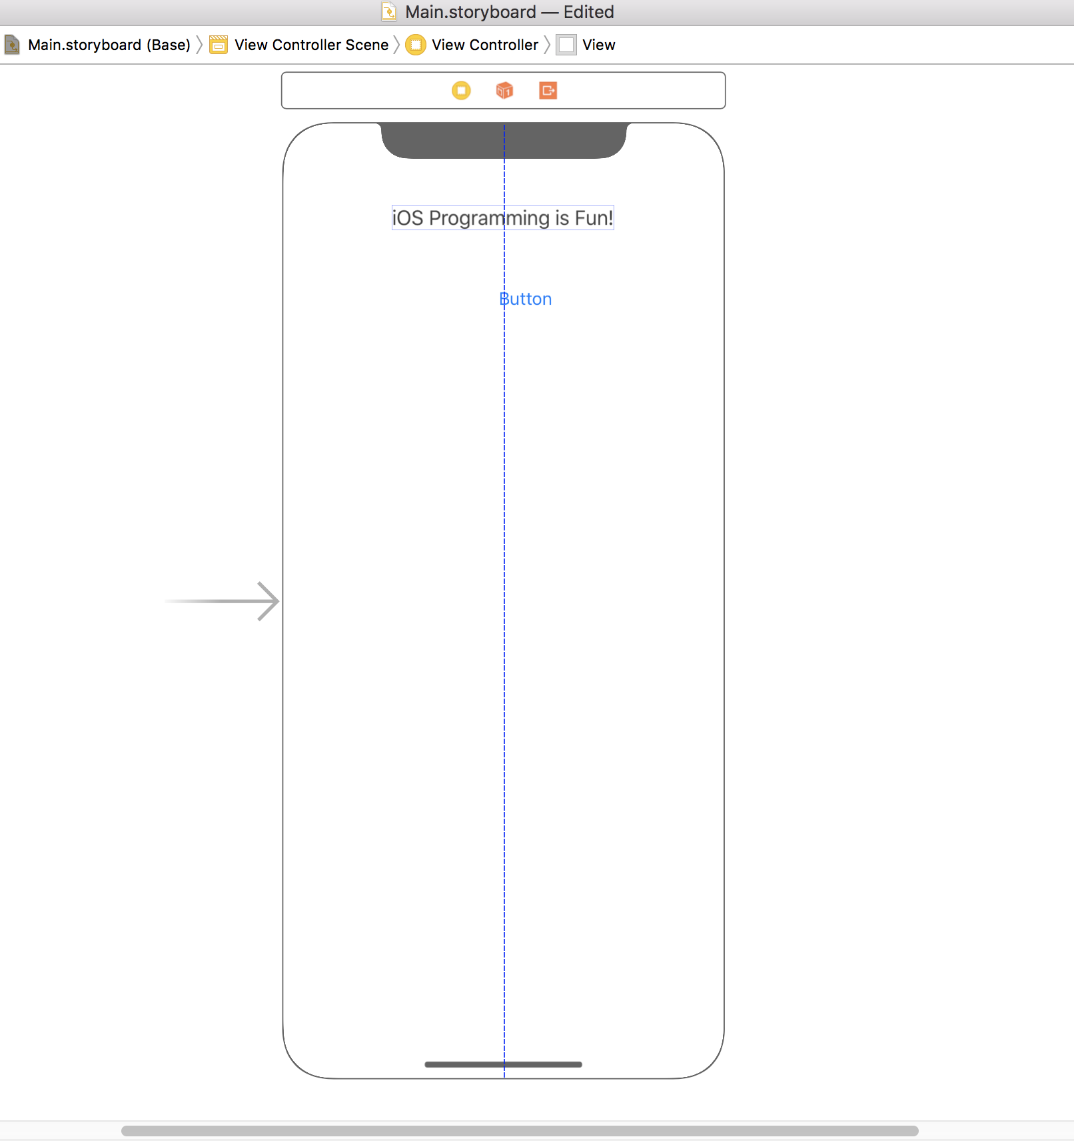
Now that we have a button and a label drag the label until it’s centered horizontally in the layout. You’ll see a blue line going down the layout when it’s center
Do the same for the button as well

Slide 26

It’s important to note, when we center the controls in the layout, we didn’t create any constraints, The blue line is just a visual guide.
Looks good right?
Let’s run it and see how it looks, but let’s run it on a device other than the one we designed the layout in.

Slide 27
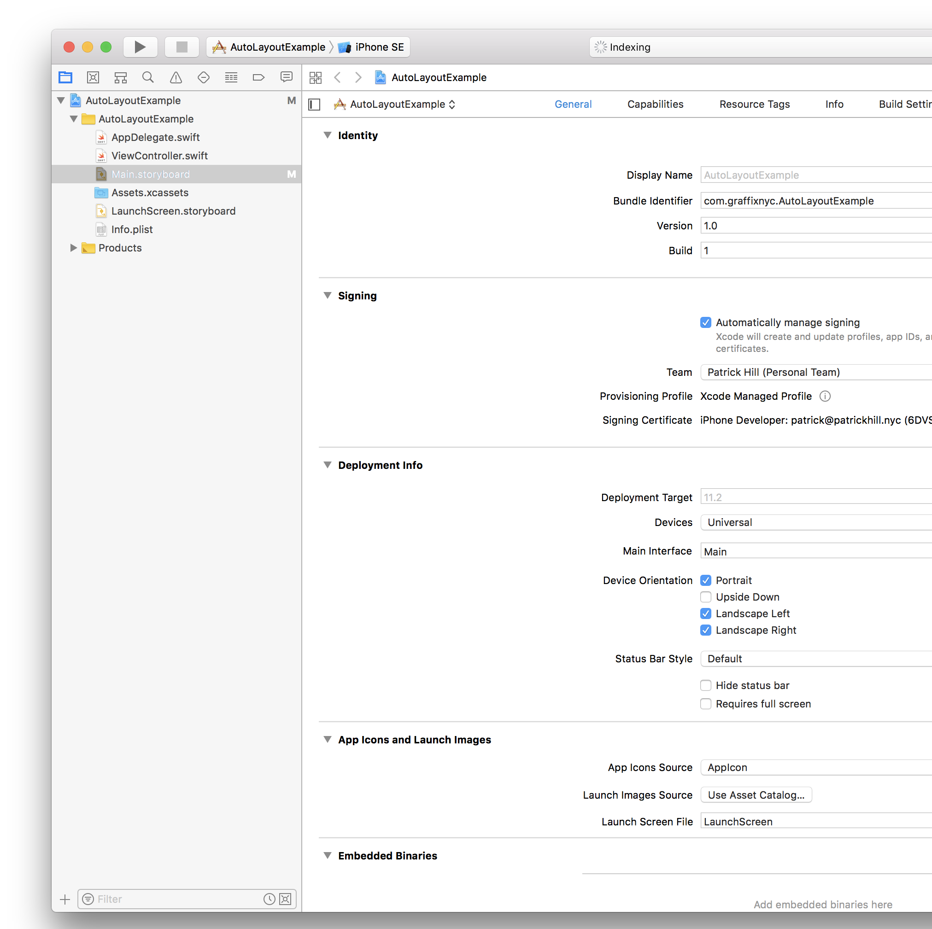
Navigate back to the main project view(minimize the interface builder) and select iPhone SE as the target and then press the play button.

Slide 28
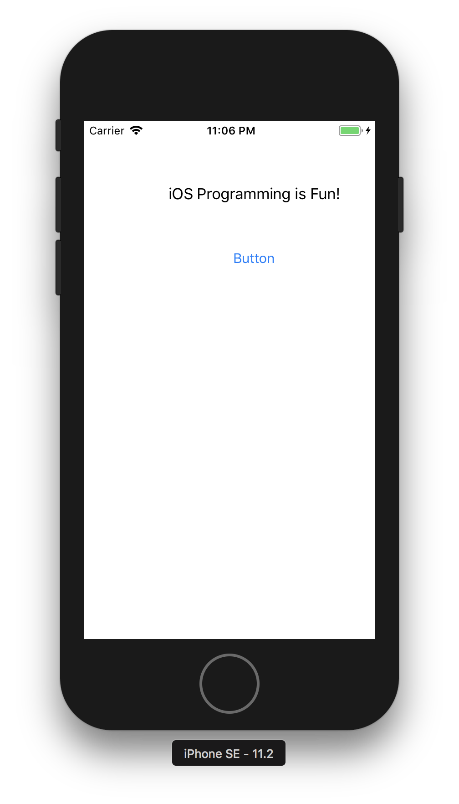
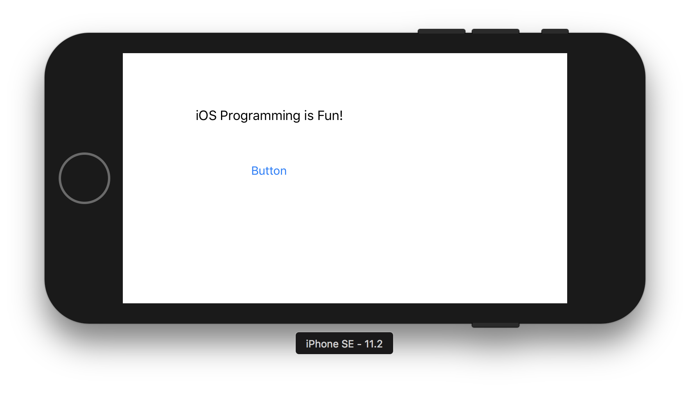
Hmm well that doesn’t look like we designed it. And it looks just as bad in landscape mode.
Let’s add some basic constraints to make it look better. We know that we want the label and the button centered horizontally no matter what and lets say we want the label 25 points from the top of the screen and the button 30 points below the label.

Slide 29
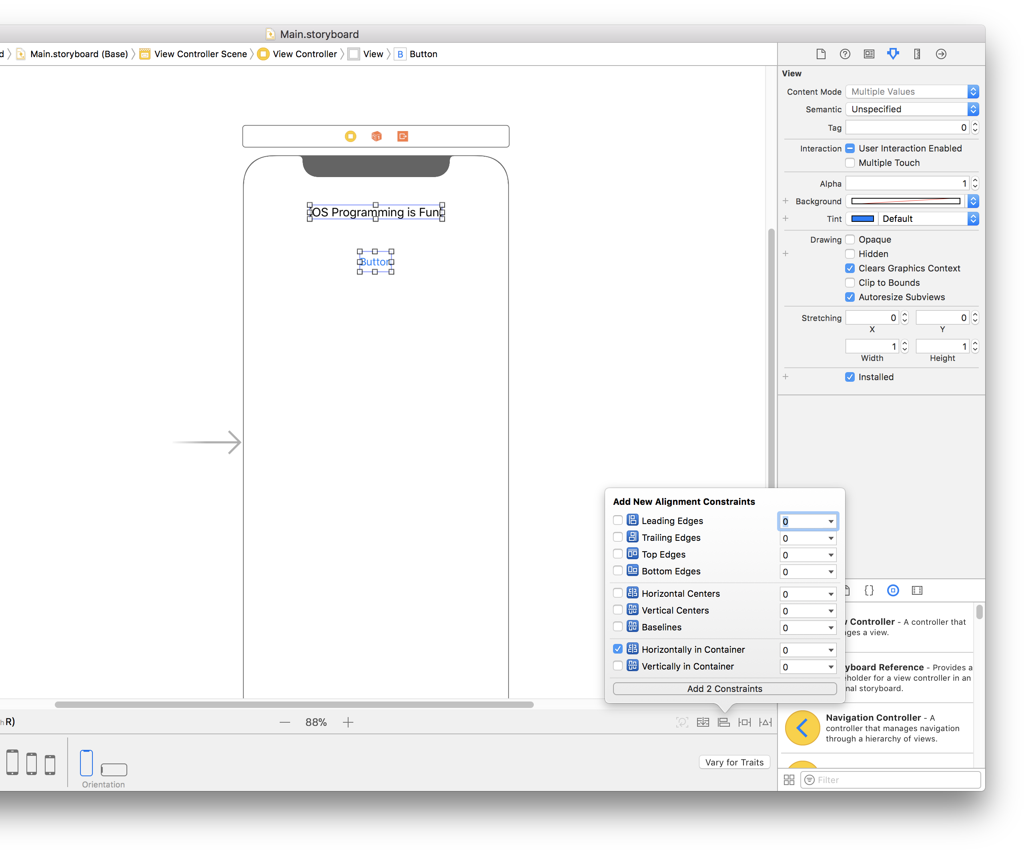
Go back to the interface builder and select both the label and the button (You can use command click to select multiple items)
Then click the “Align” icon on the bottom right, check “Horizontally in Container and then click “Add 2 Constraints”

Slide 30
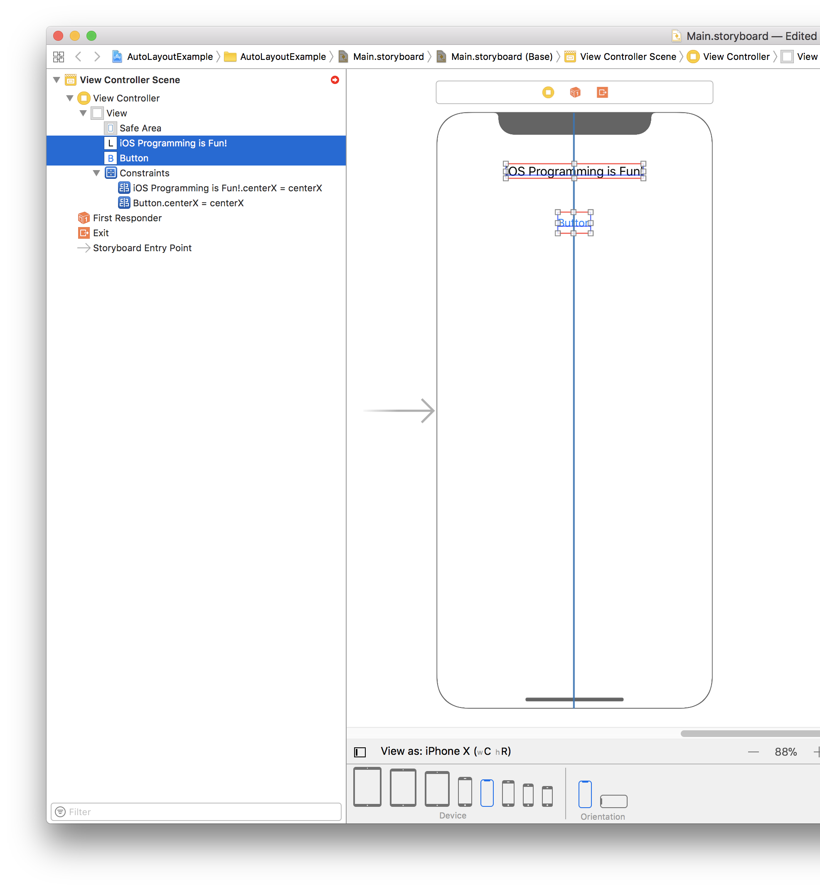
When we add the two center constraints we can see 3 things happened.
The label and the button now have a red box around them showing the constraint.
Constraints were added to the view hierarchy. Now this label and button will always be centered horizontally no matter what size device or orientation
We can see we have a little red arrow at the top, this is telling us that we are missing some constraints.
3
2
1

Slide 31
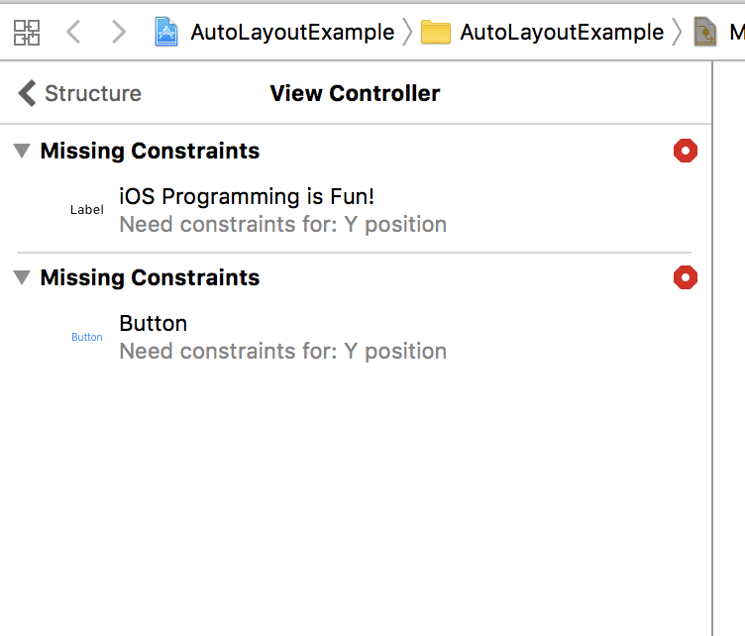
When we click the red arrow from the previous slide (#3) it tells us which constraints are missing
We will now pin the label to the top of the screen (we specify how far from the top we want it) and we will set the button to be 30 points below the label.

Slide 32
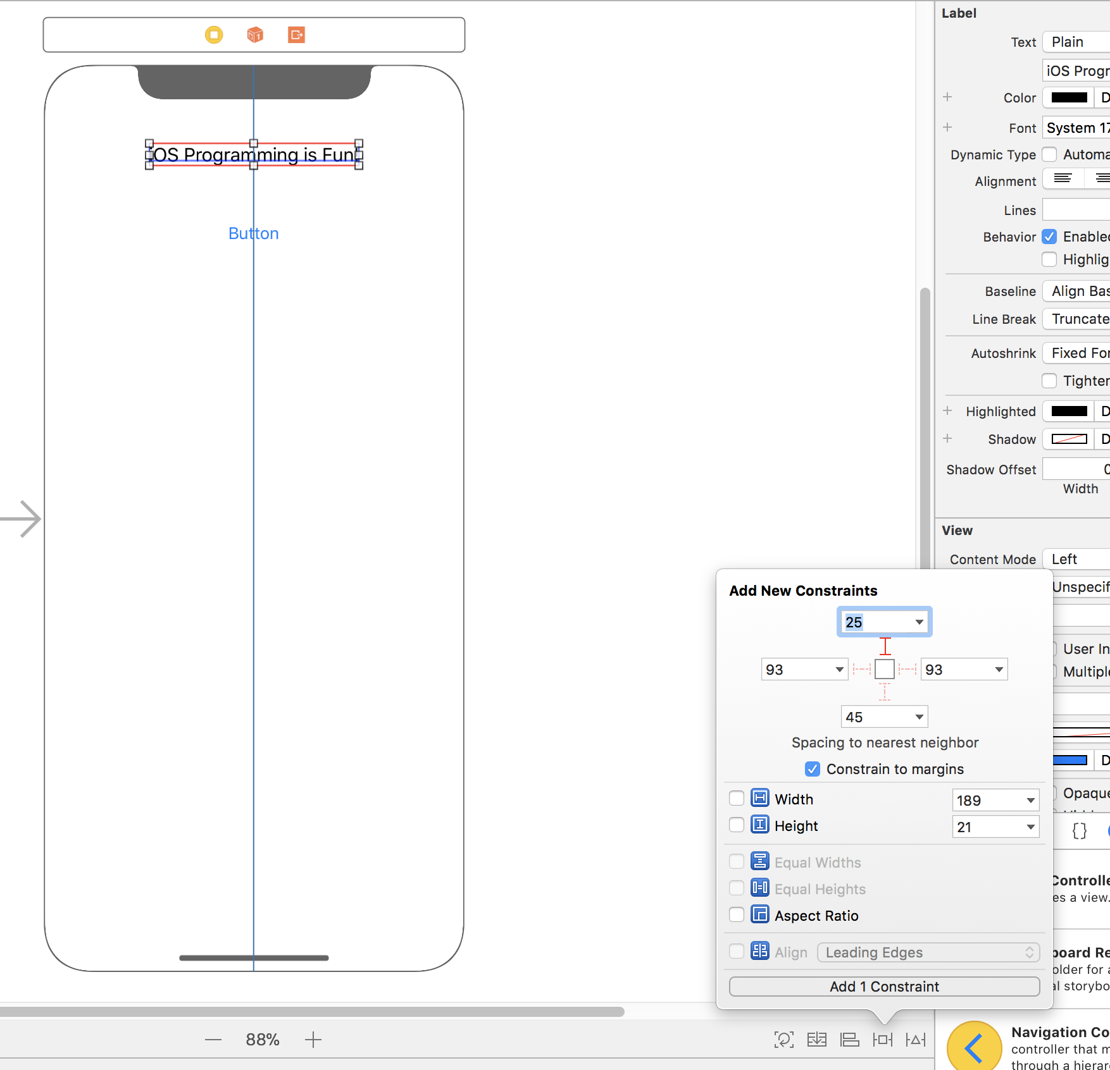
Now select the label, and then click the pin option on the bottom right, it’s right next to the Align one from before. Click the top I-beam so so it’s dark and type 25 into the top textbox and then click the “Add 1 Constraint” button

Slide 33
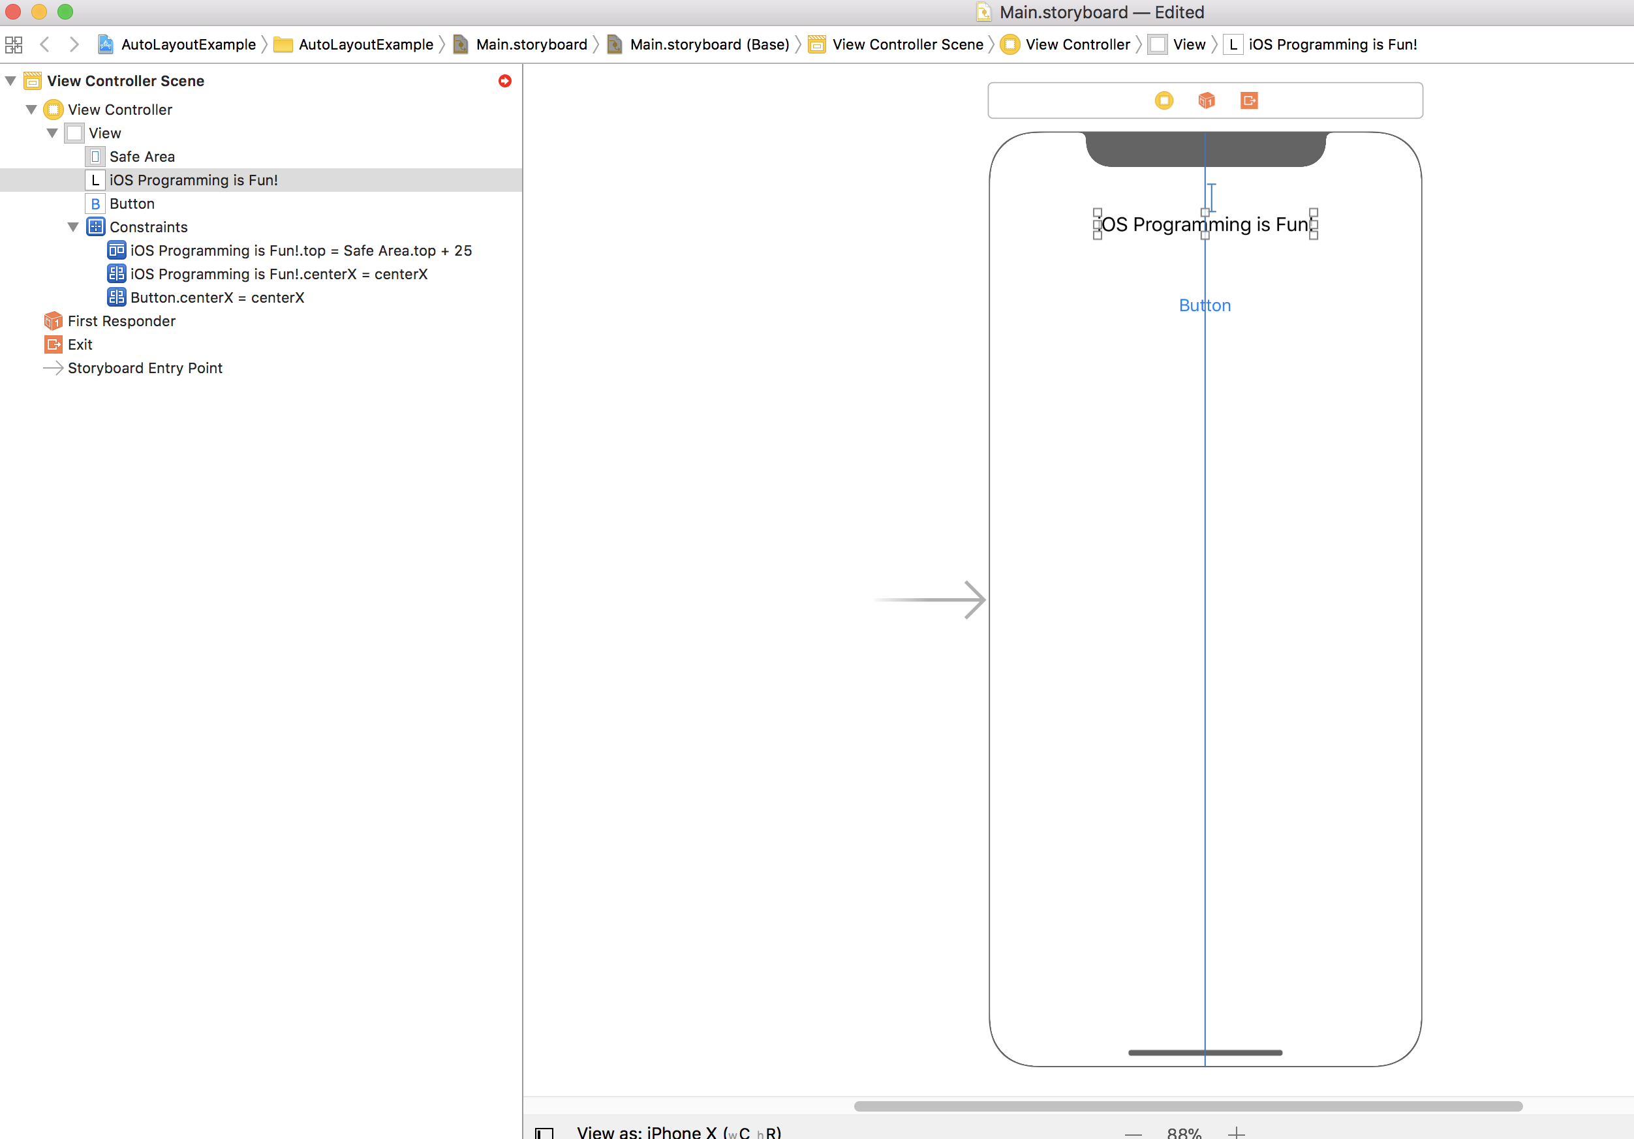
We can now see on the interface builder we get an I-beam showing the constraint and we can see it added the constraint to the view hierarchy. Now this label will always be displayed 25 points from the top of the screen no matter what size device or orientation
We just have to add one more constraint to the button to tell it to always be 30 points below the label

Slide 34
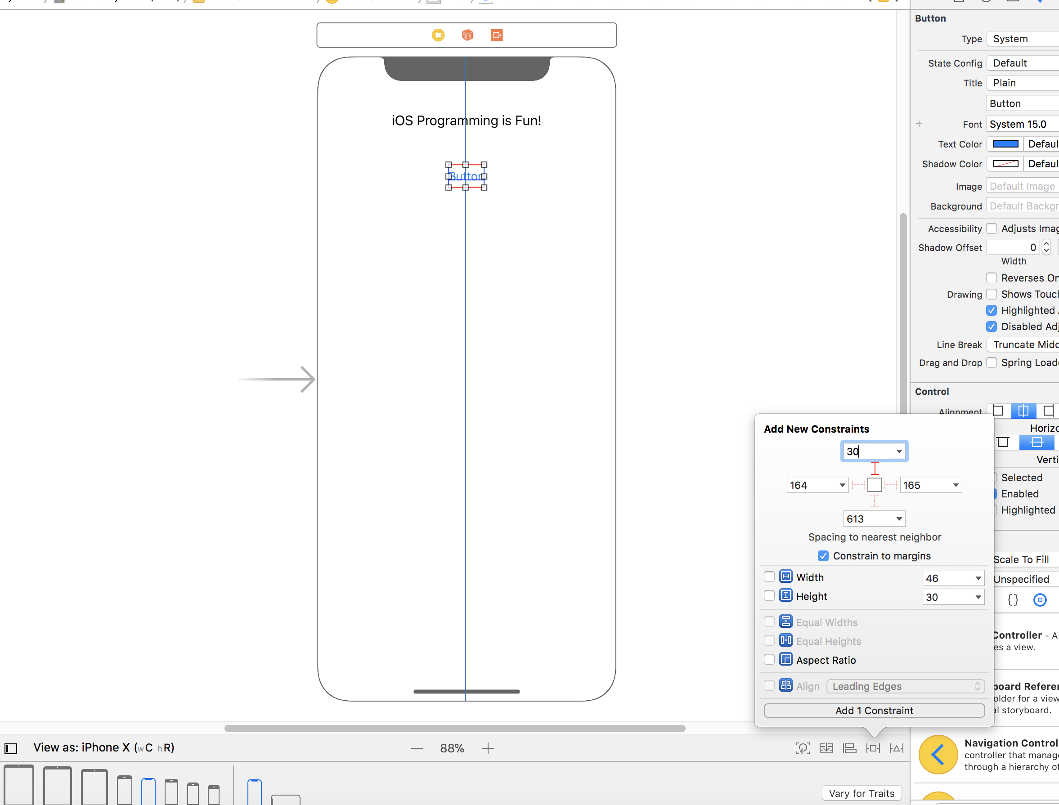
Now select the button, and then click the pin option again on the bottom right. Click the top I-beam so so it’s dark and type 30 into the top textbox and then click the “Add 1 Constraint” button

Slide 35
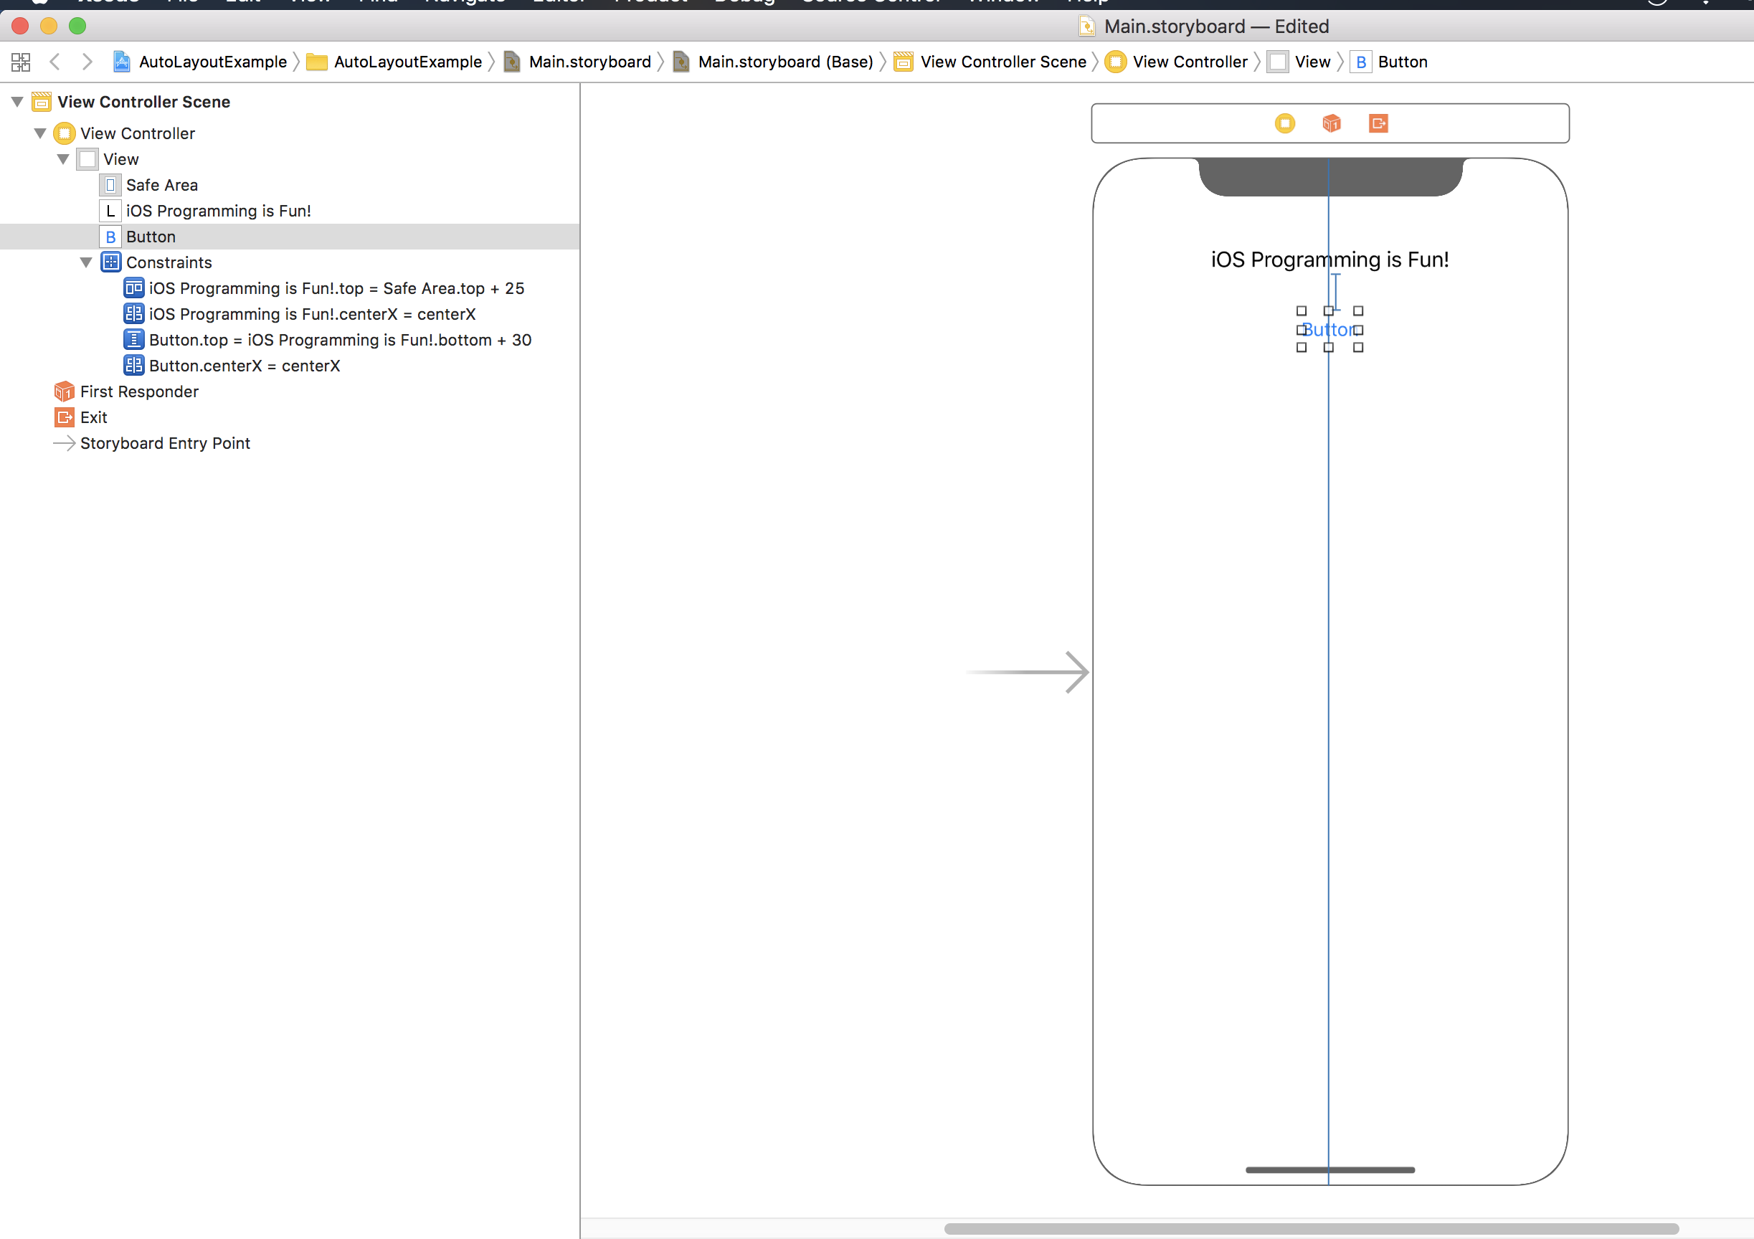
We can now see on the interface builder we get an I-beam showing the constraint and we can see it added the constraint to the view hierarchy. Now this button will always be displayed 30 points below the label no matter what size device or orientation.
We can also see that the missing constraint error has gone away!
Lets run it again on the iPhone SE and see how it looks now!

Slide 36
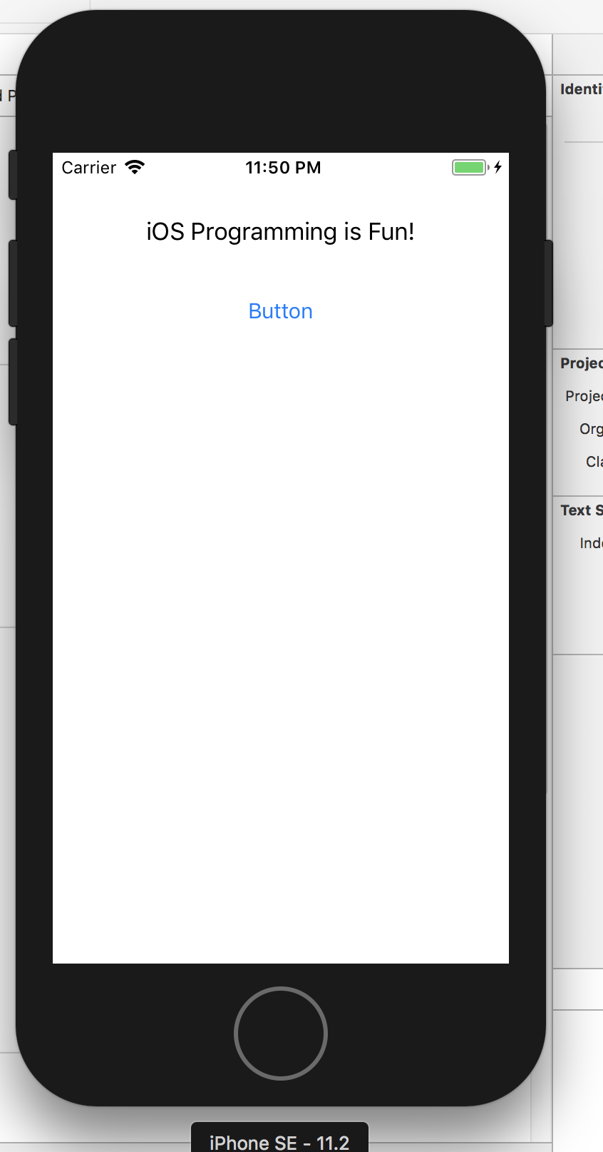
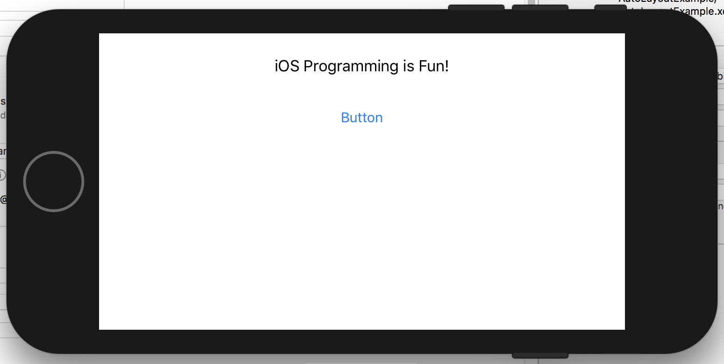
iPhone SE
Looks much better!
Let’s look at it on the iPhone X and 8 Plus as well

Slide 37
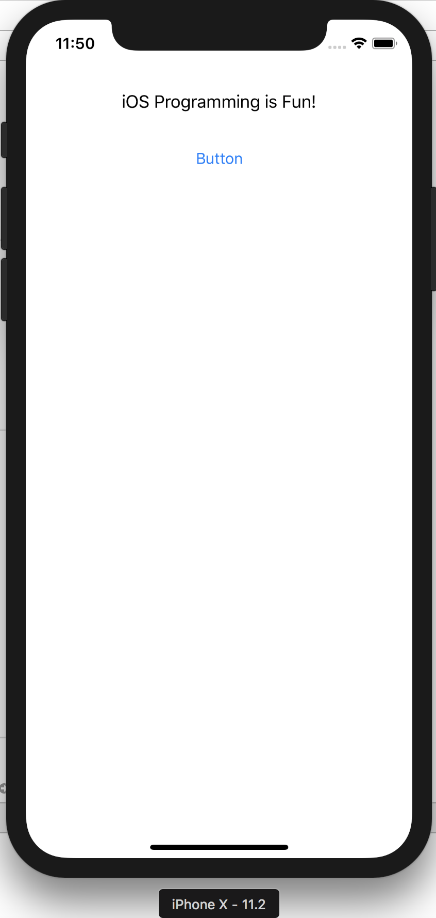
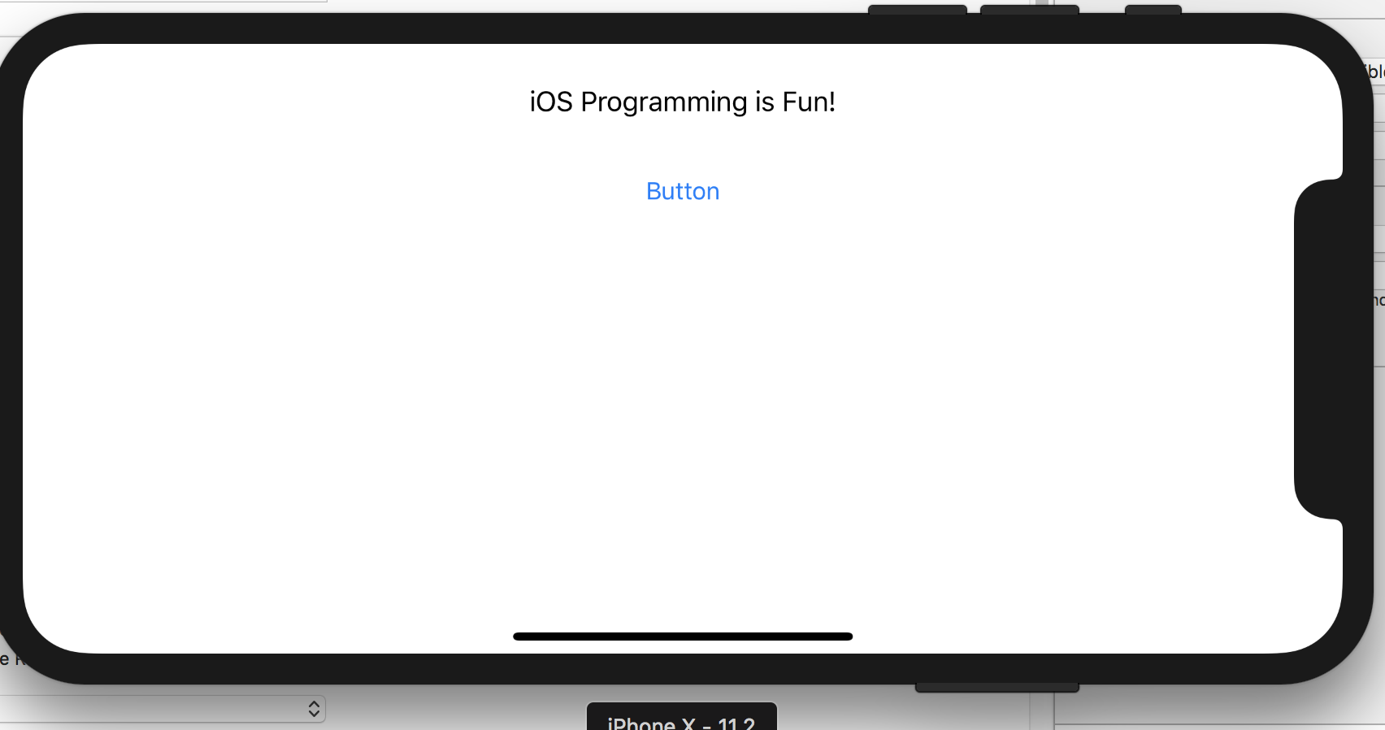
iPhone X

Slide 38
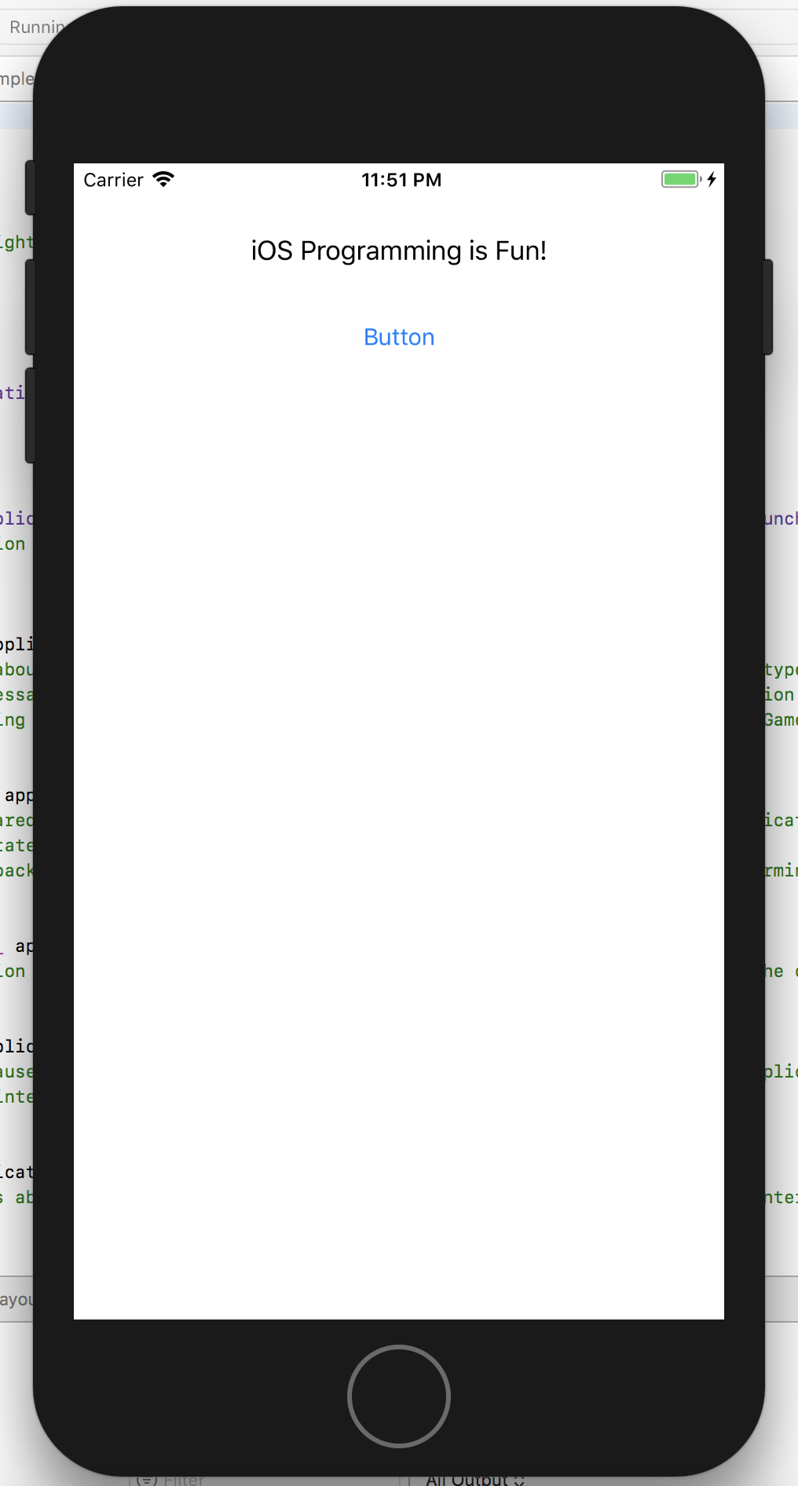
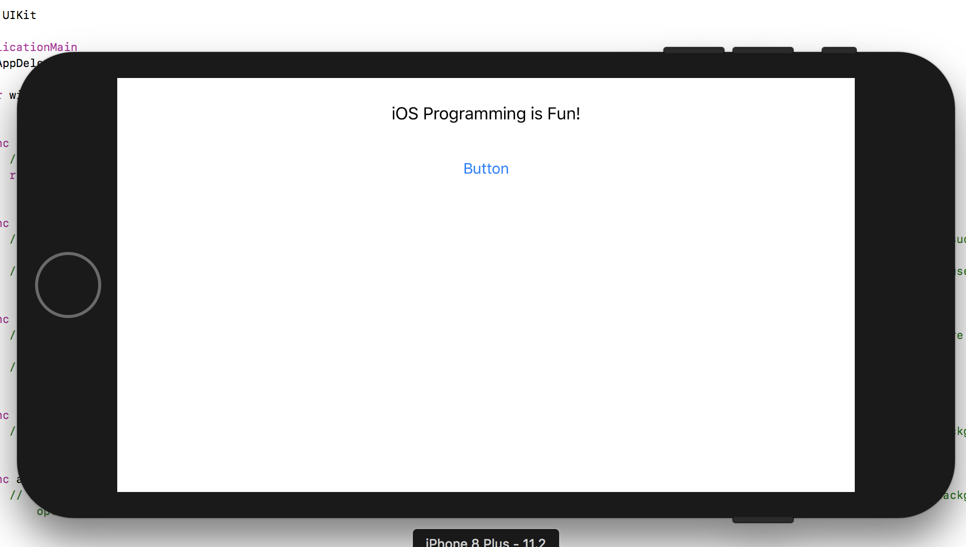
iPhone 8 Plus
We can see that the UI looks much better and is more consistent than it was before.
We will now work on an in class lab that will get us more familiar with Auto Layouts and other UI views. We will create an application with 2 labels, a text field and a button and use the auto layout to layout and position the views in the root view

